Slide 1
ROCKETS
Reference
Field Return Manual

Slide 2
TYPES
AT-4
Light-weight Anti-armor Weapon (LAW)
Shoulder-Launched Multi-Purpose Assault Weapon (SMAW)

Slide 3
AT-4
C995
Cartridge and Launcher, 84mm M136 AT-4

Slide 4
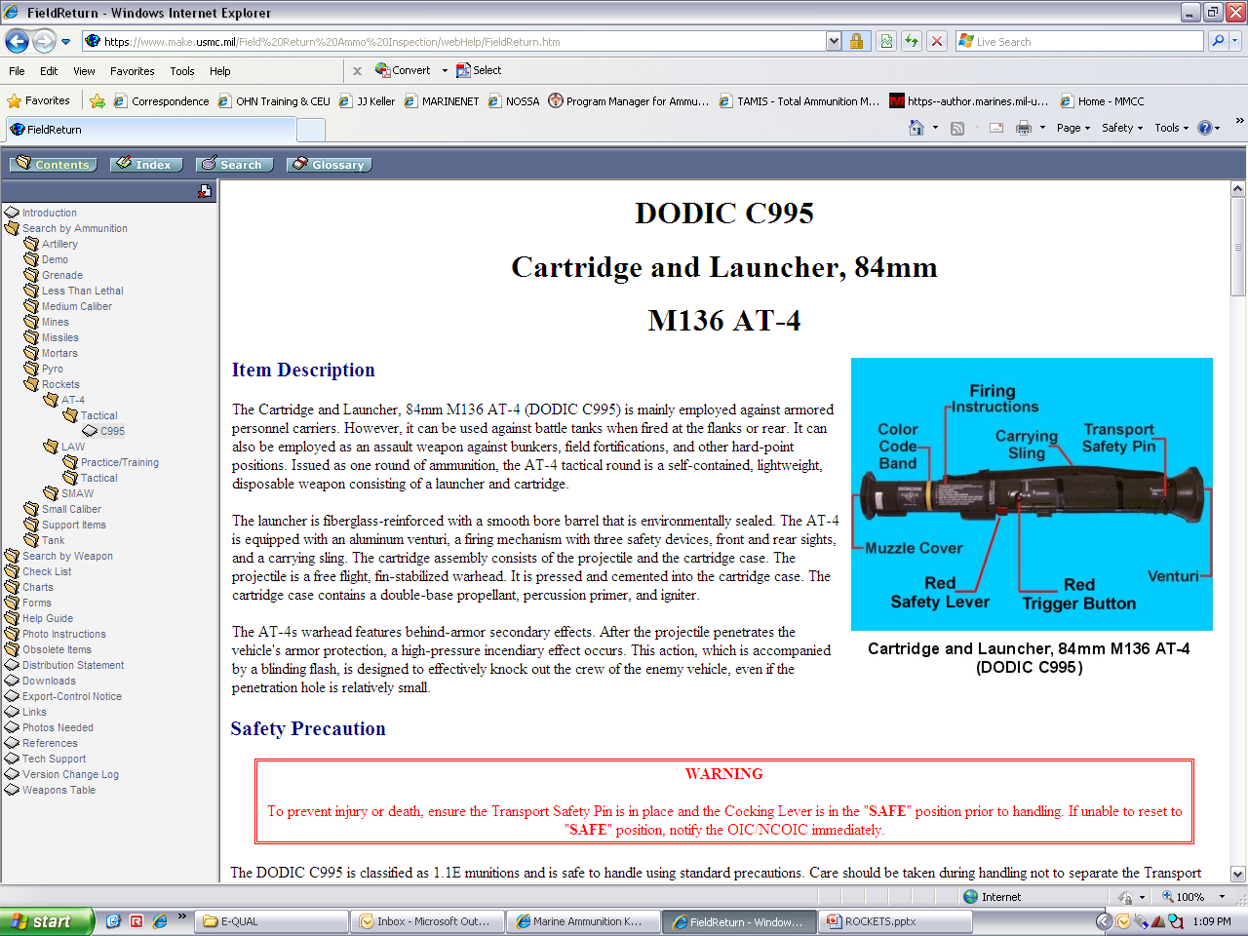
C995
CARTRIDGE AND LAUNCHER, 84MM M136 AT-4

Slide 5
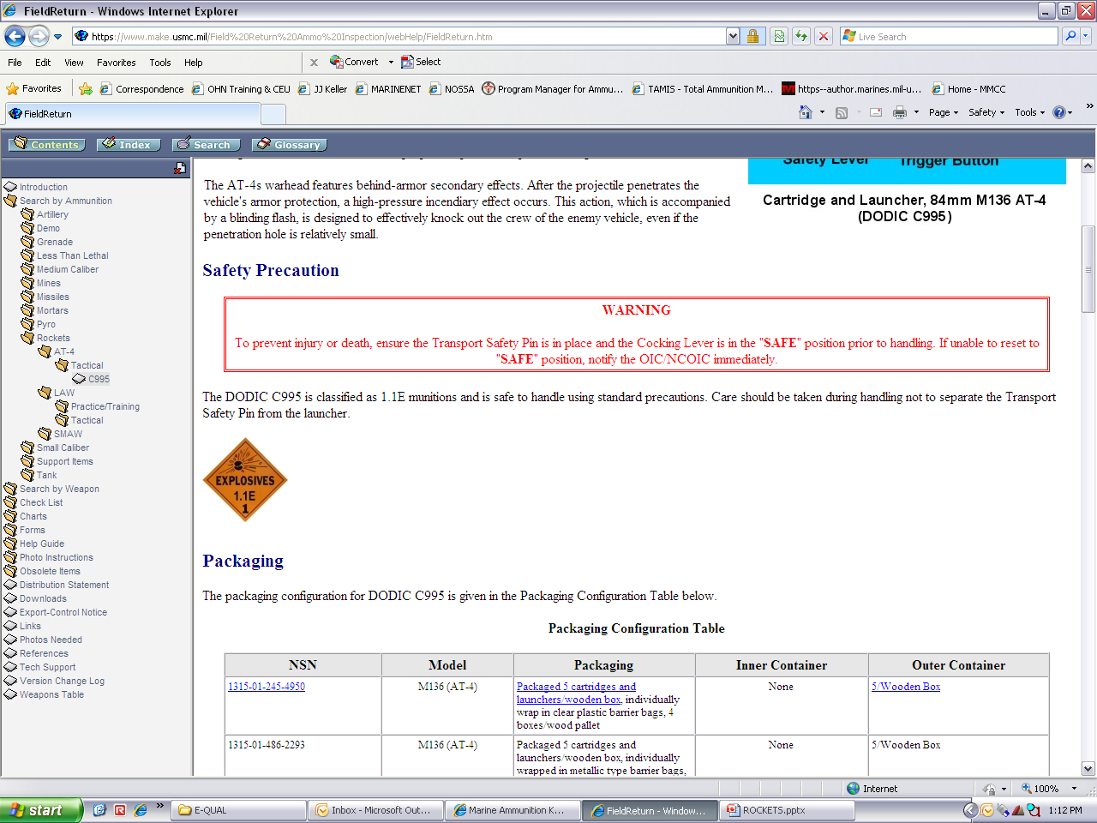
Safety precautions

Slide 6
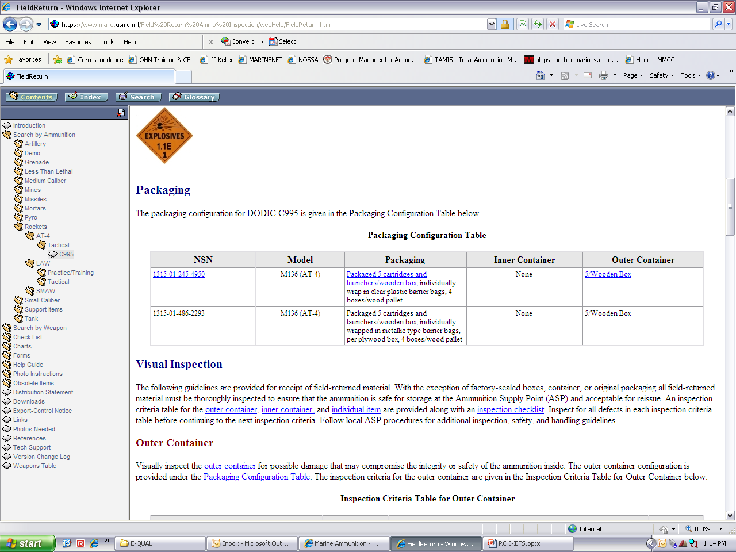
Packaging

Slide 7
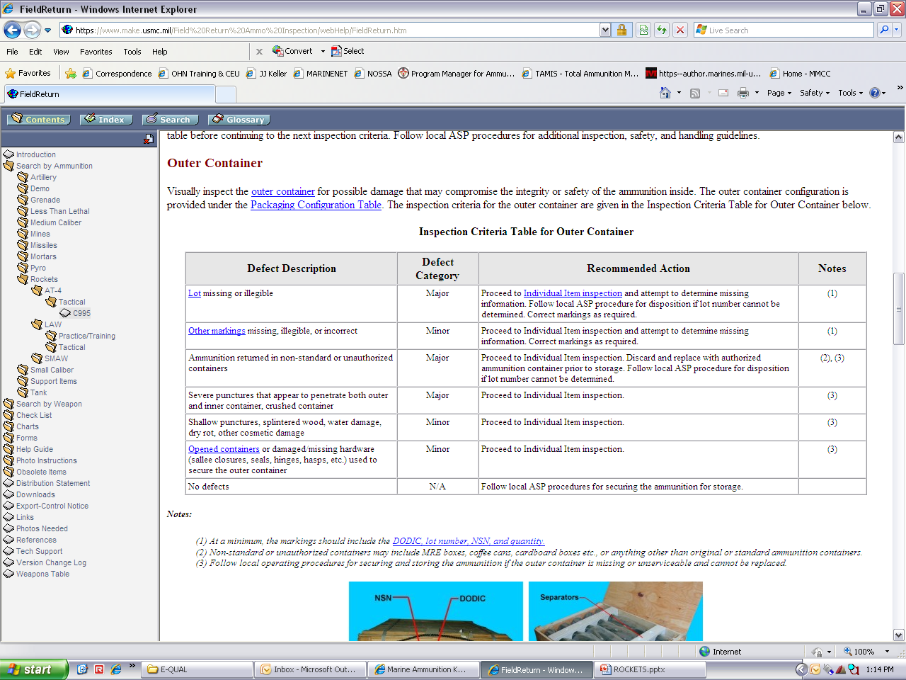
OUTER CONTAINER checklist

Slide 8
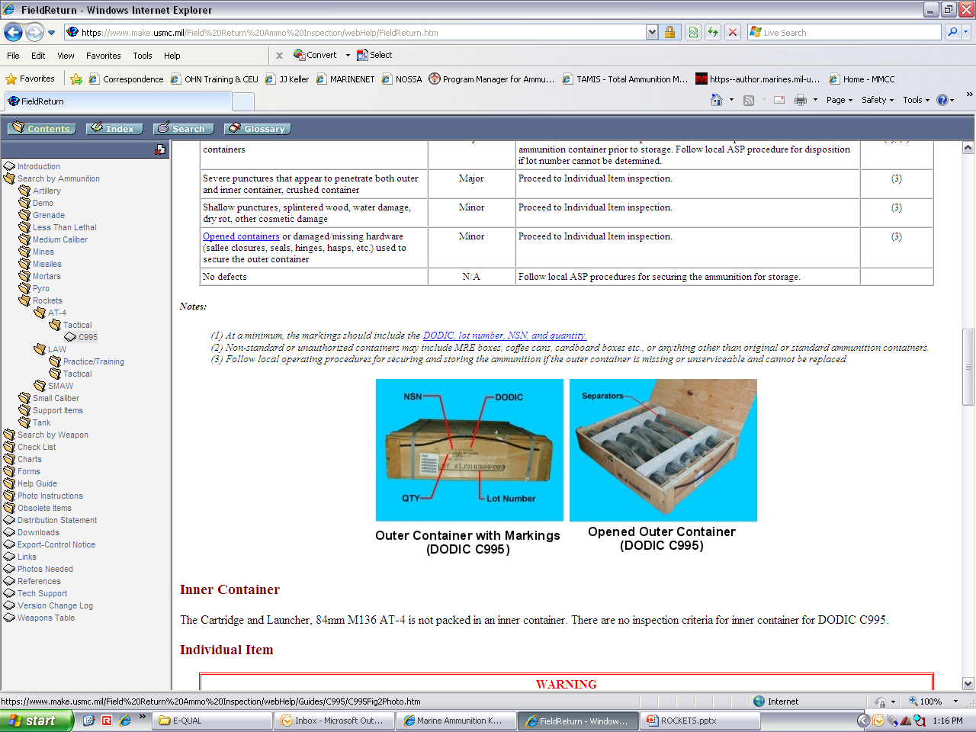
OUTER CONTAINER checklist
(CONT)

Slide 9
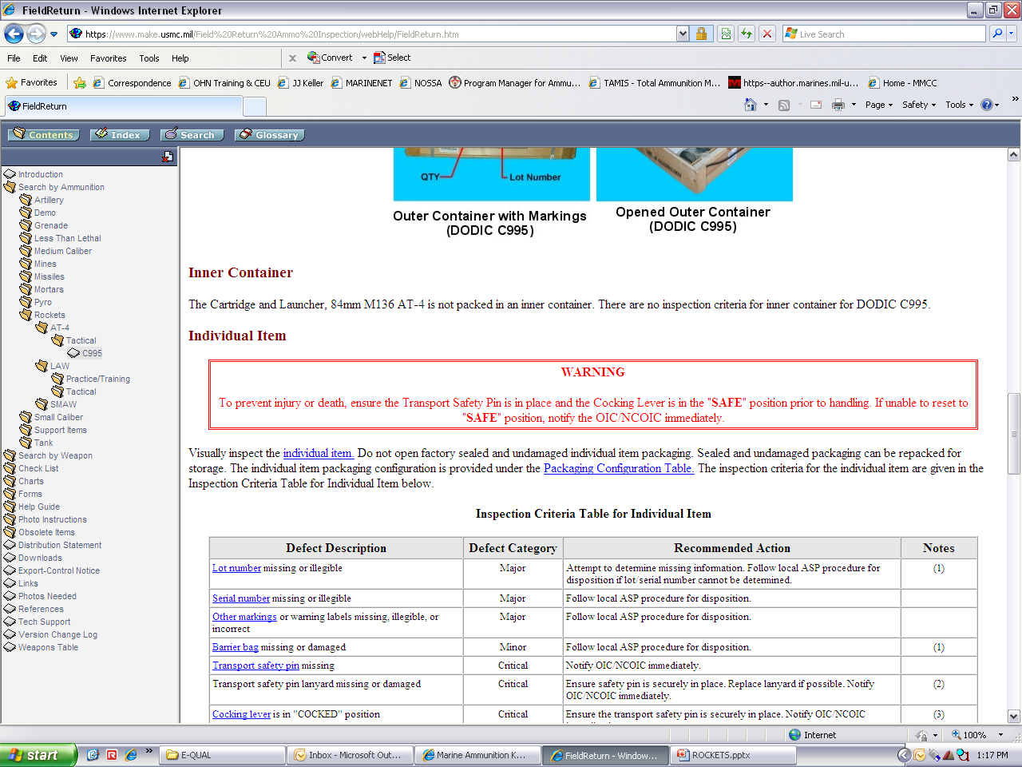
INNER CONTAINER CHECKLIST

Slide 10
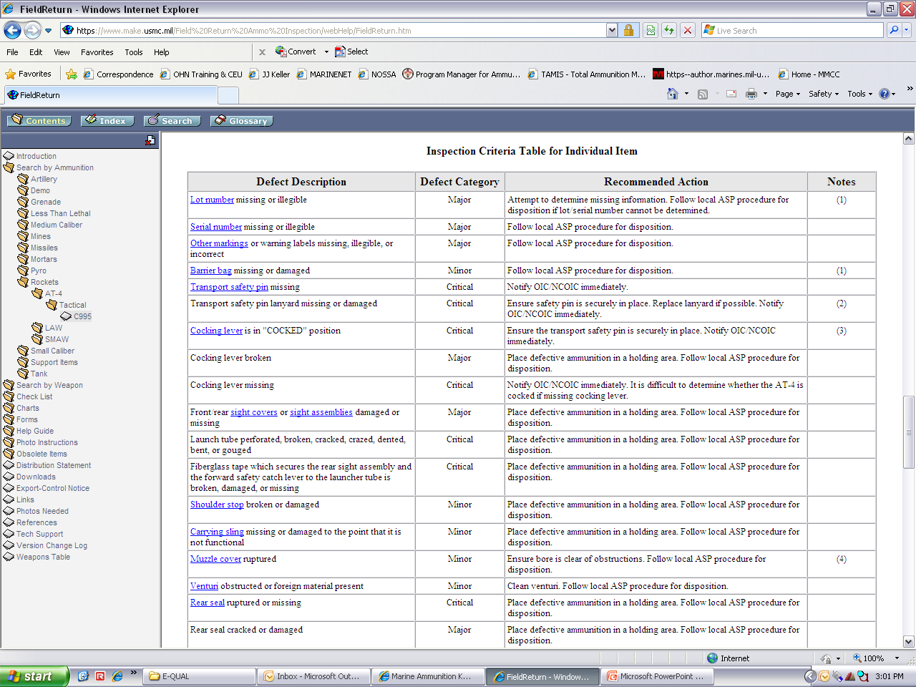
INDIVIDUAL ITEM CHECKLIST

Slide 11
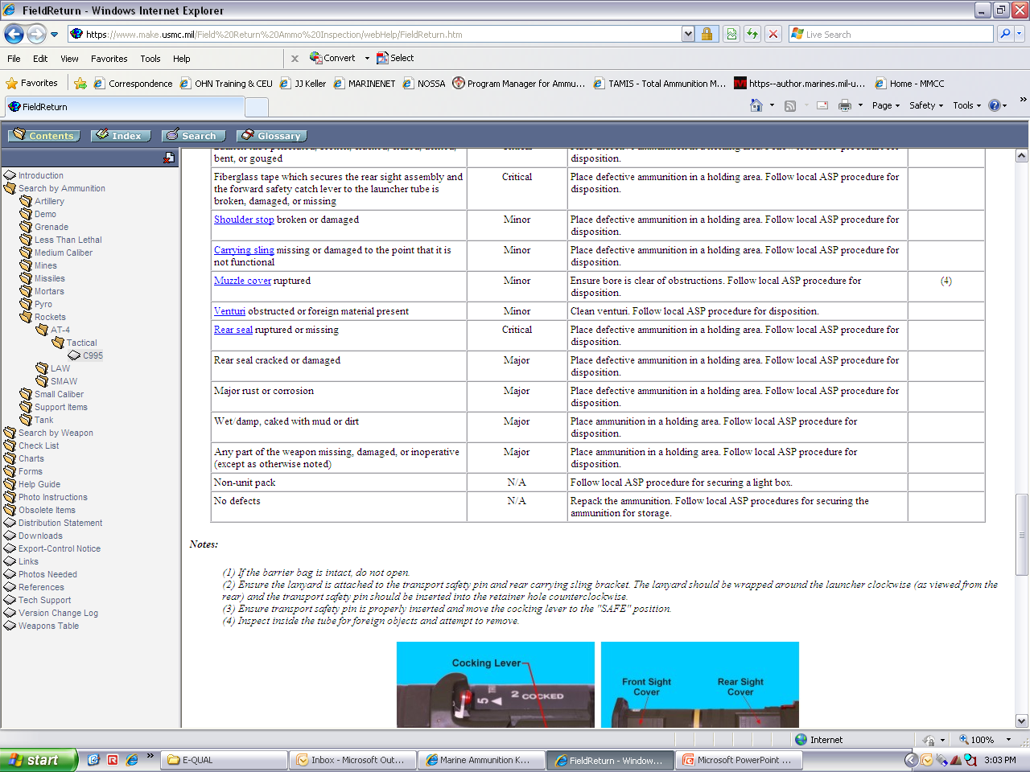
INDIVIDUAL ITEM CHECKLIST
(cont)

Slide 12
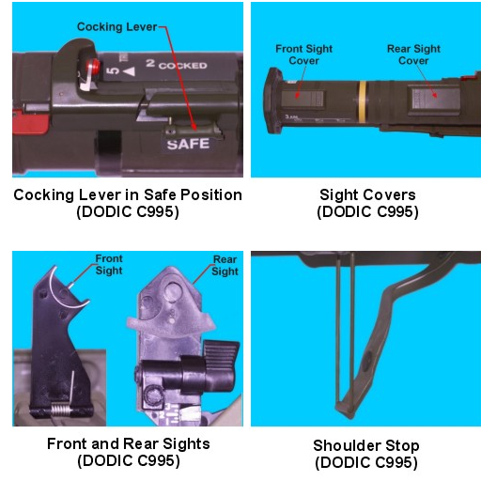
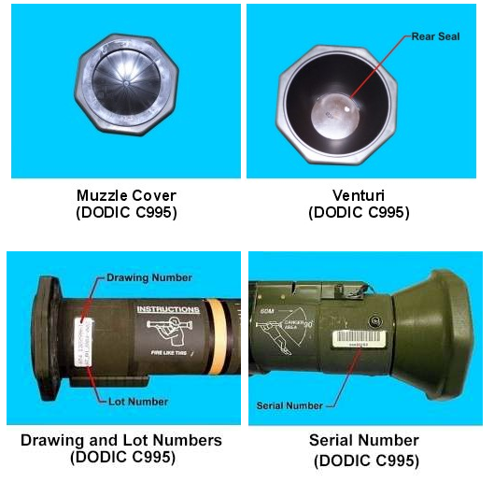
INDIVIDUAL ITEM CHECKLIST
(cont)

Slide 13
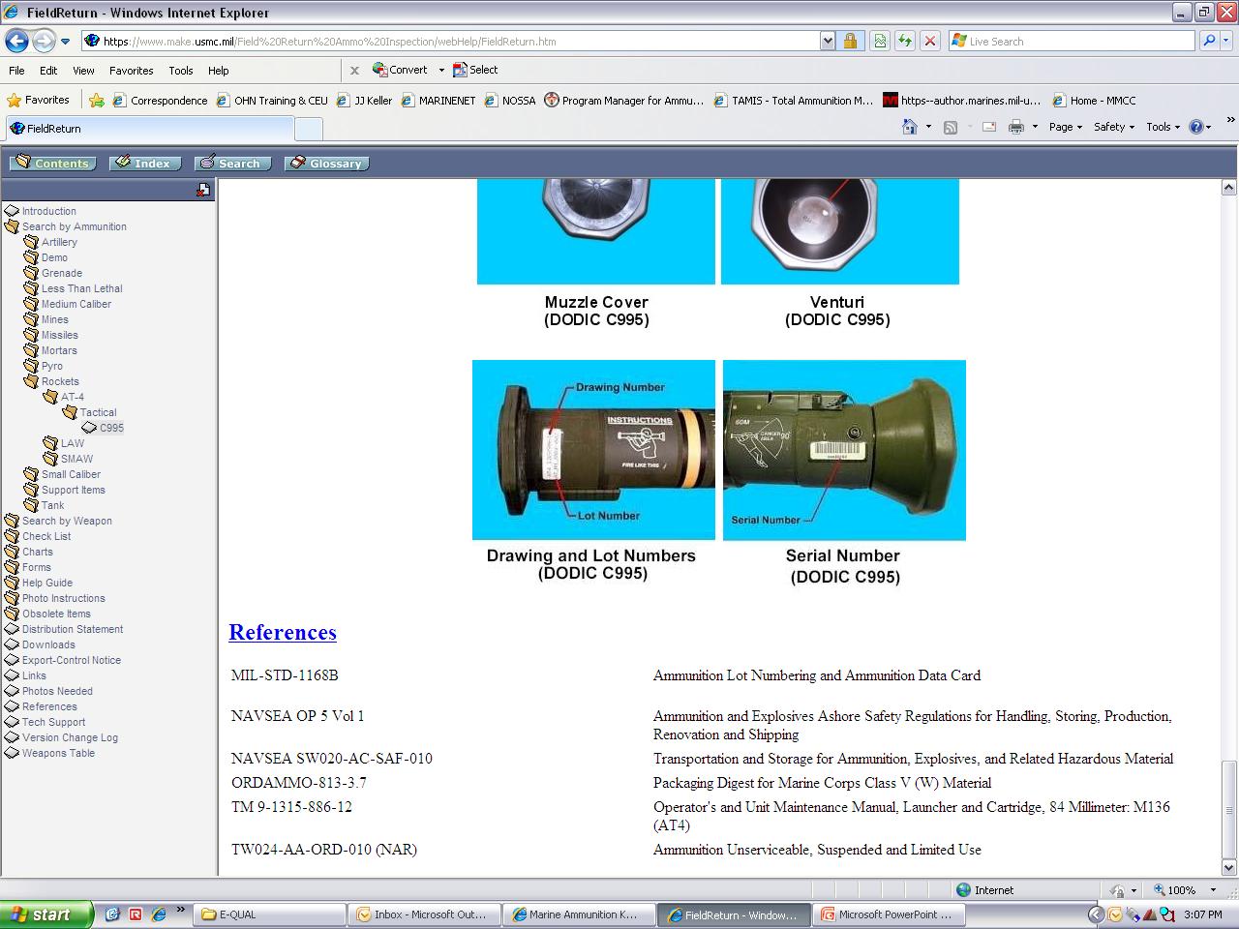
REFERENCES

Slide 14
LIGHT-WEIGHT ANTI-ARMOR WEAPON (LAW)
HA29
HA21
Rocket, 66mm, HE, M72A7 LAW with Graze
Rocket Assembly, 21mm M72AS LAW Trainer

Slide 15
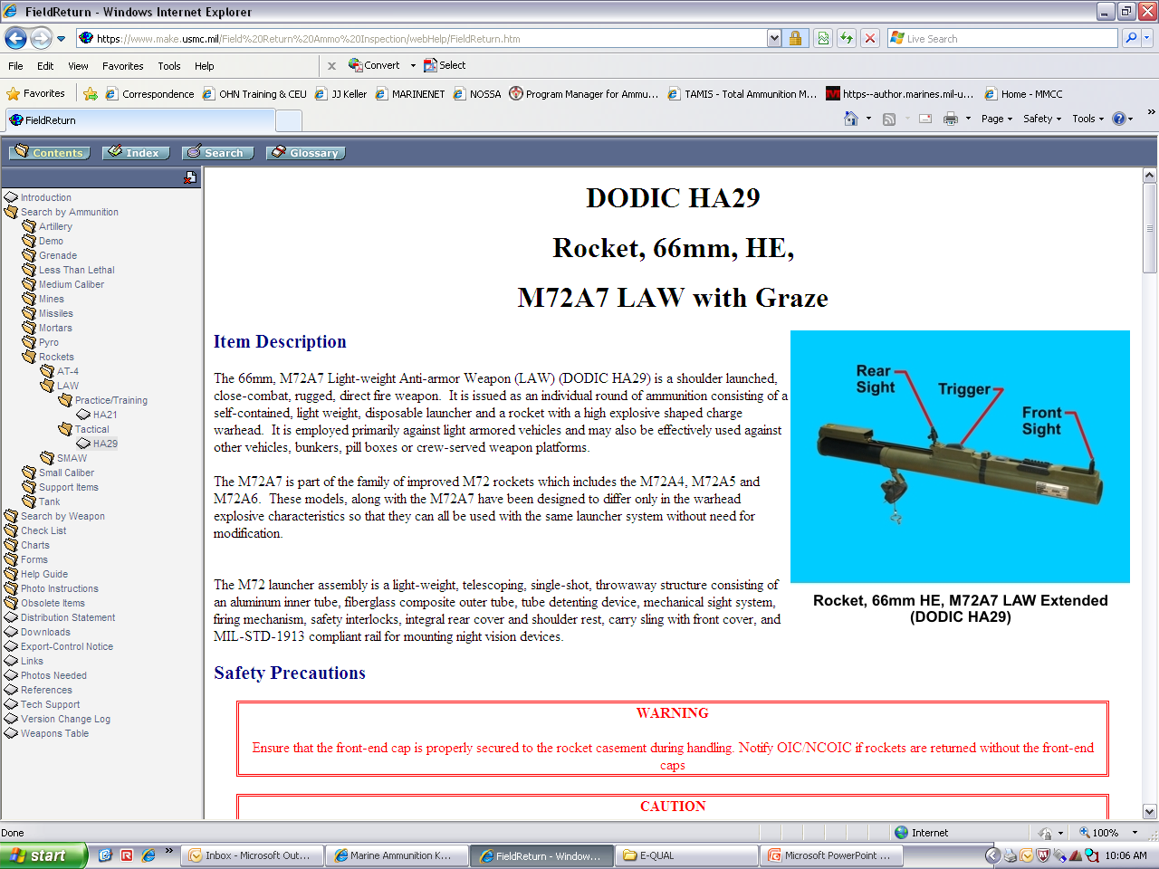
HA29
ROCKET, 66MM, HE
M72A7 LAW WITH GRAZE

Slide 16
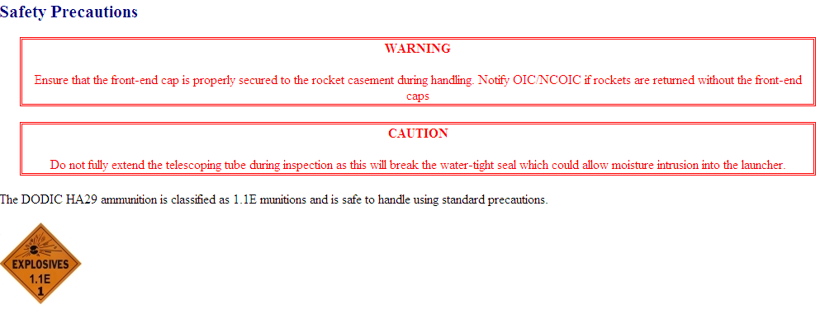
Safety precautions

Slide 17
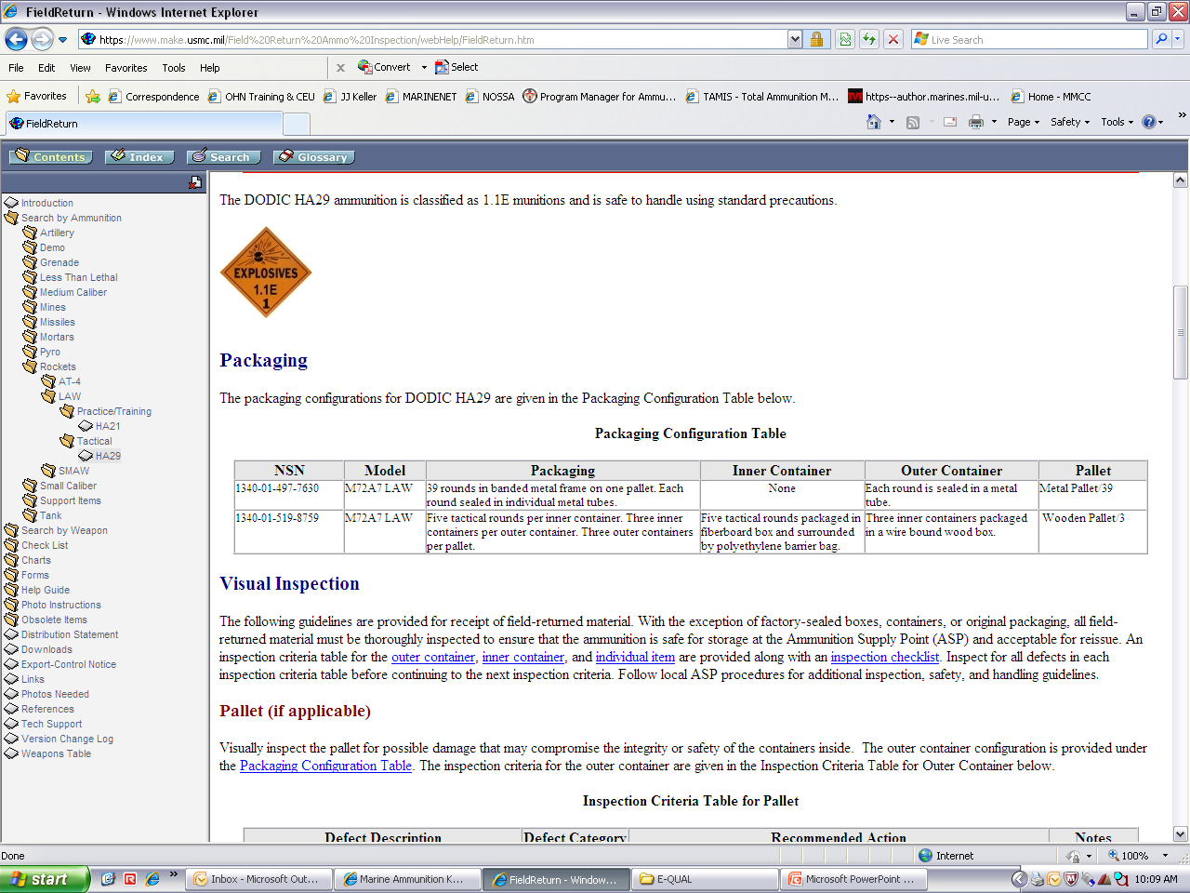
Packaging

Slide 18
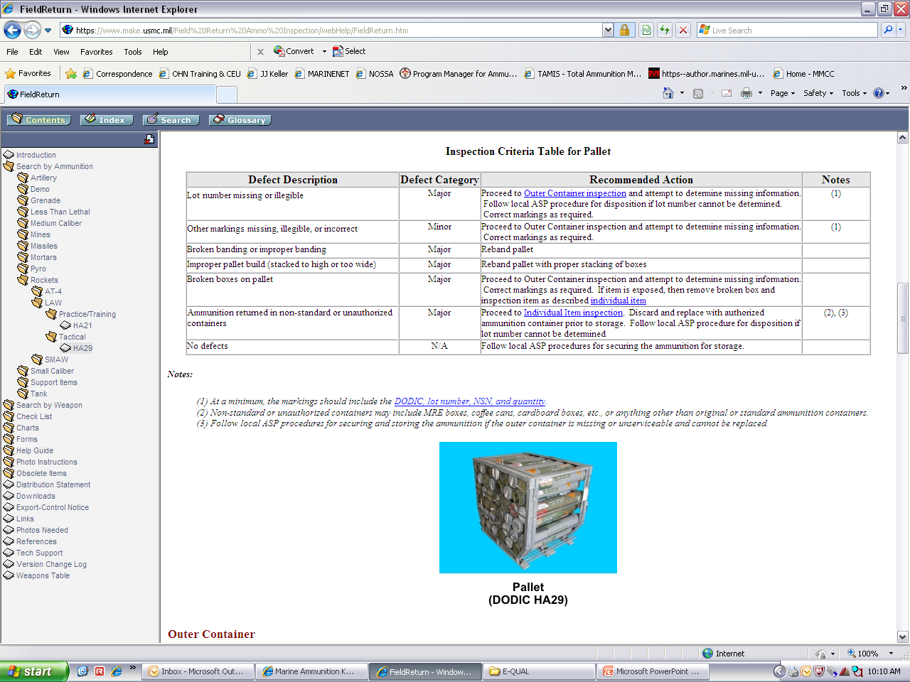
PALLET CHECKLIST

Slide 19
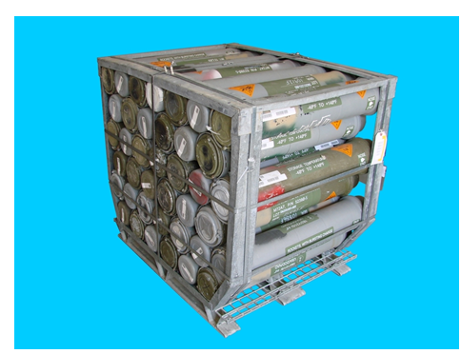
PALLET CHECKLIST (CONT)

Slide 20
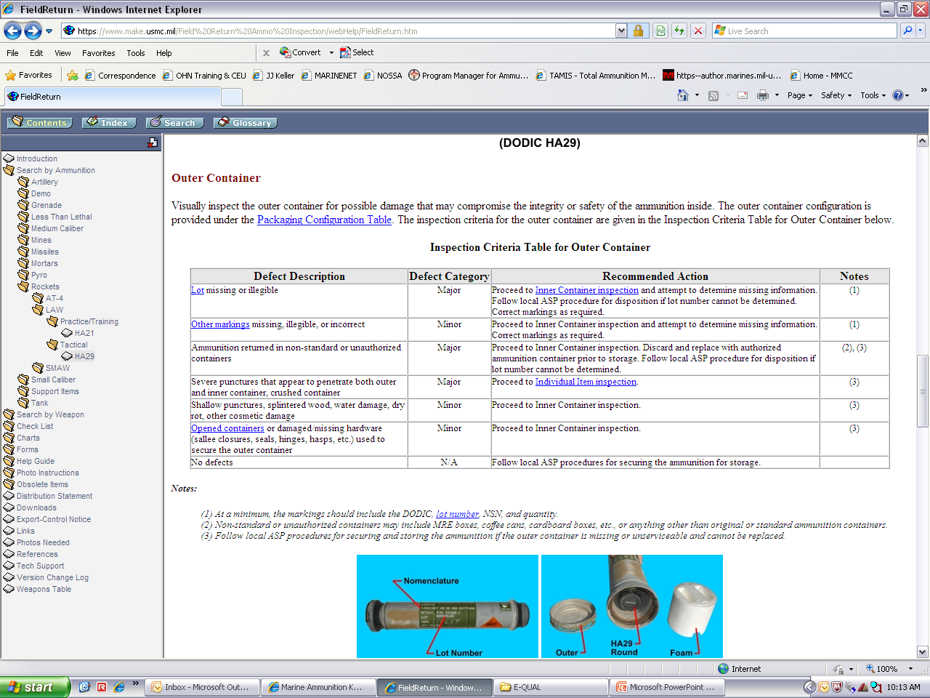
OUTER CONTAINER checklist

Slide 21
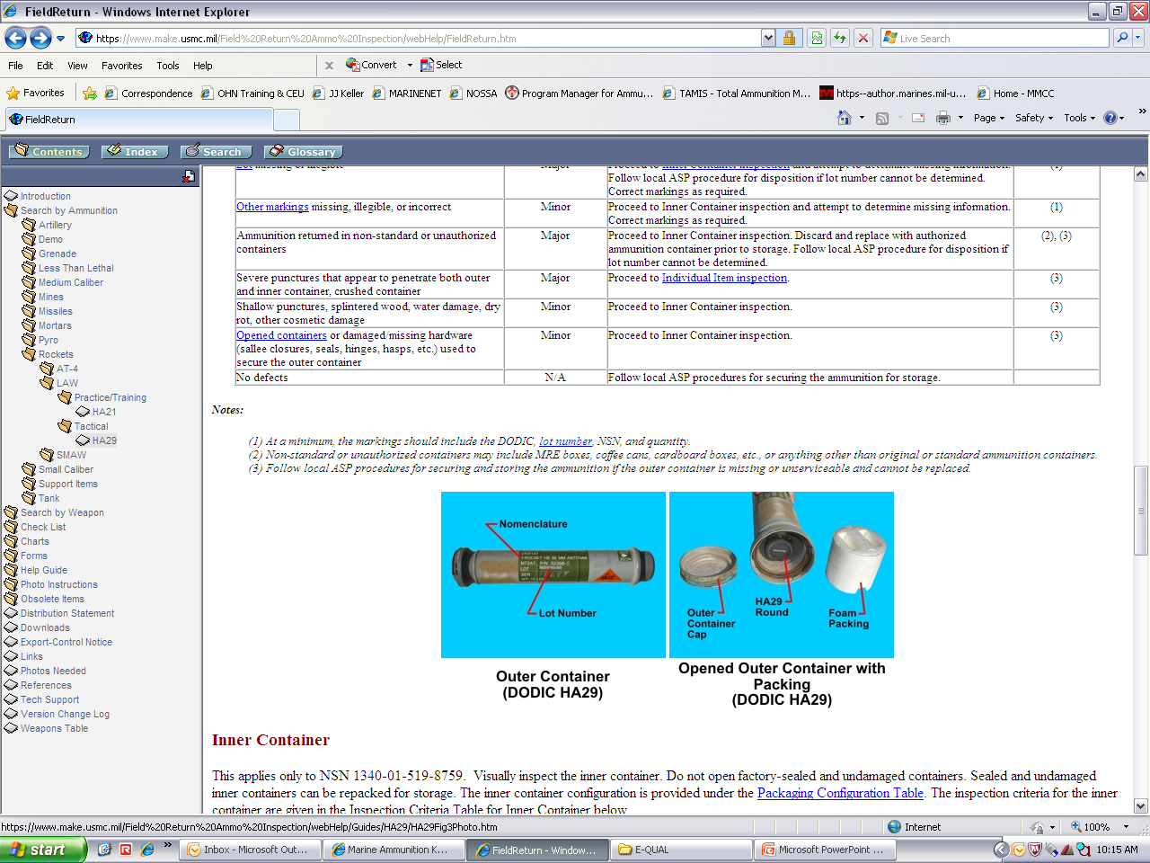
OUTER CONTAINER checklist
(CONT)

Slide 22
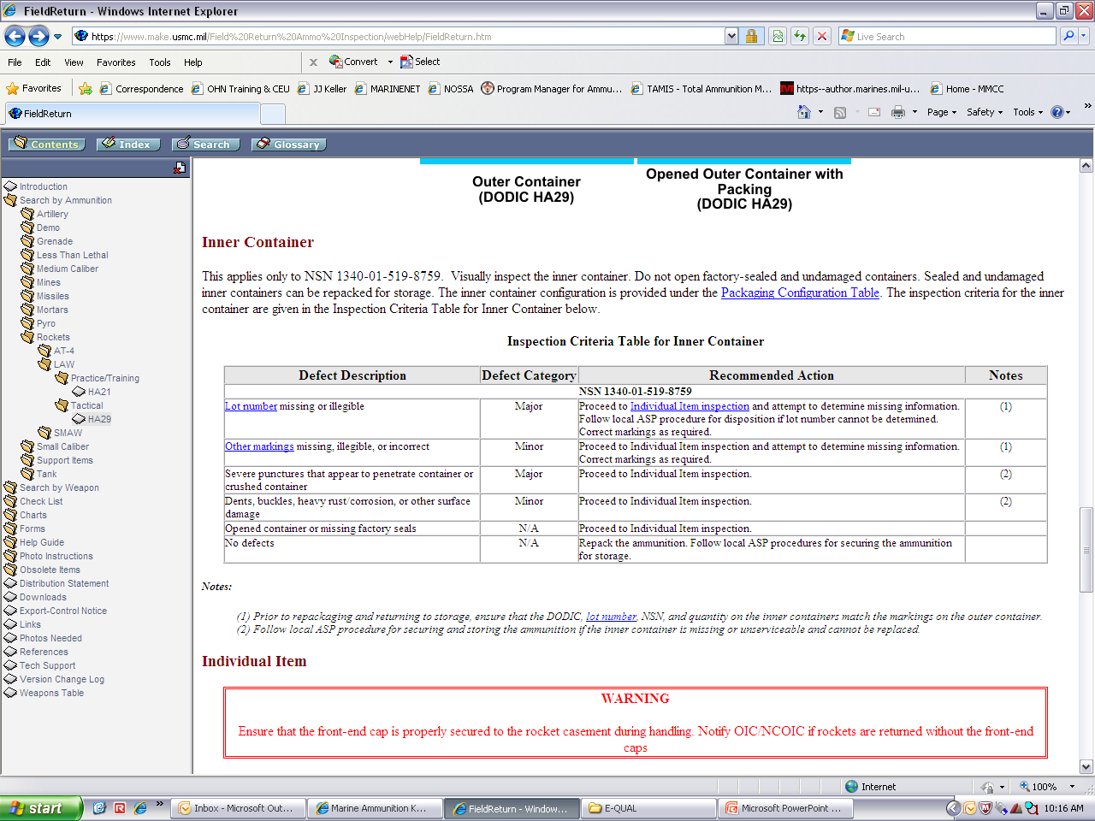
INNER CONTAINER CHECKLIST

Slide 23
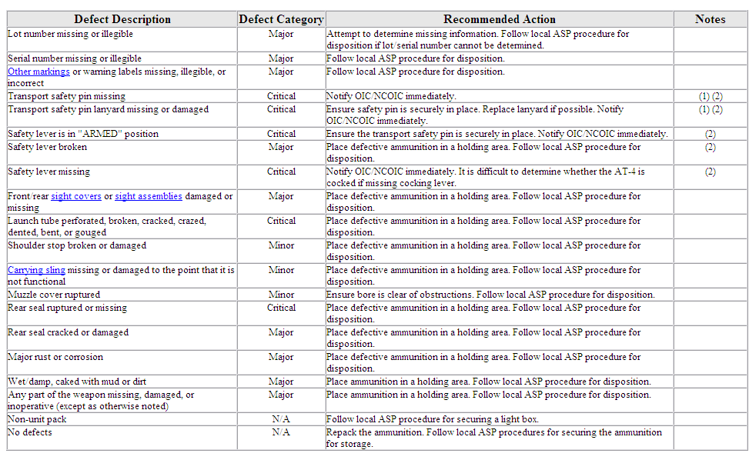
INDIVIDUAL ITEM CHECKLIST

Slide 24
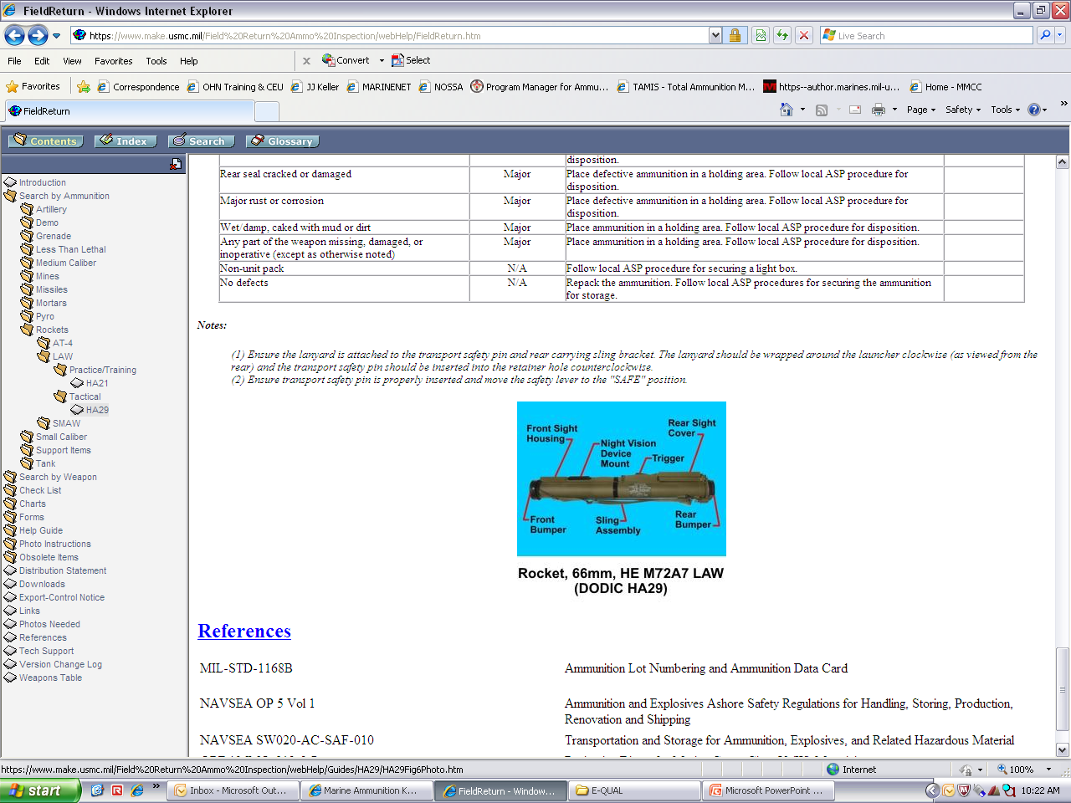
INDIVIDUAL ITEM CHECKLIST
(cont)

Slide 25
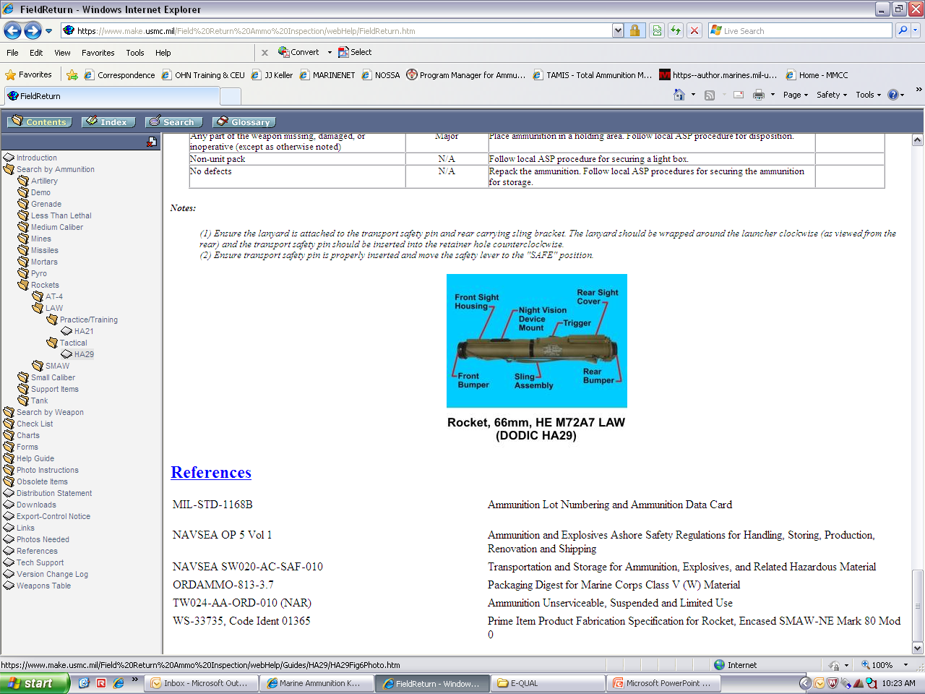
REFERENCES

Slide 26
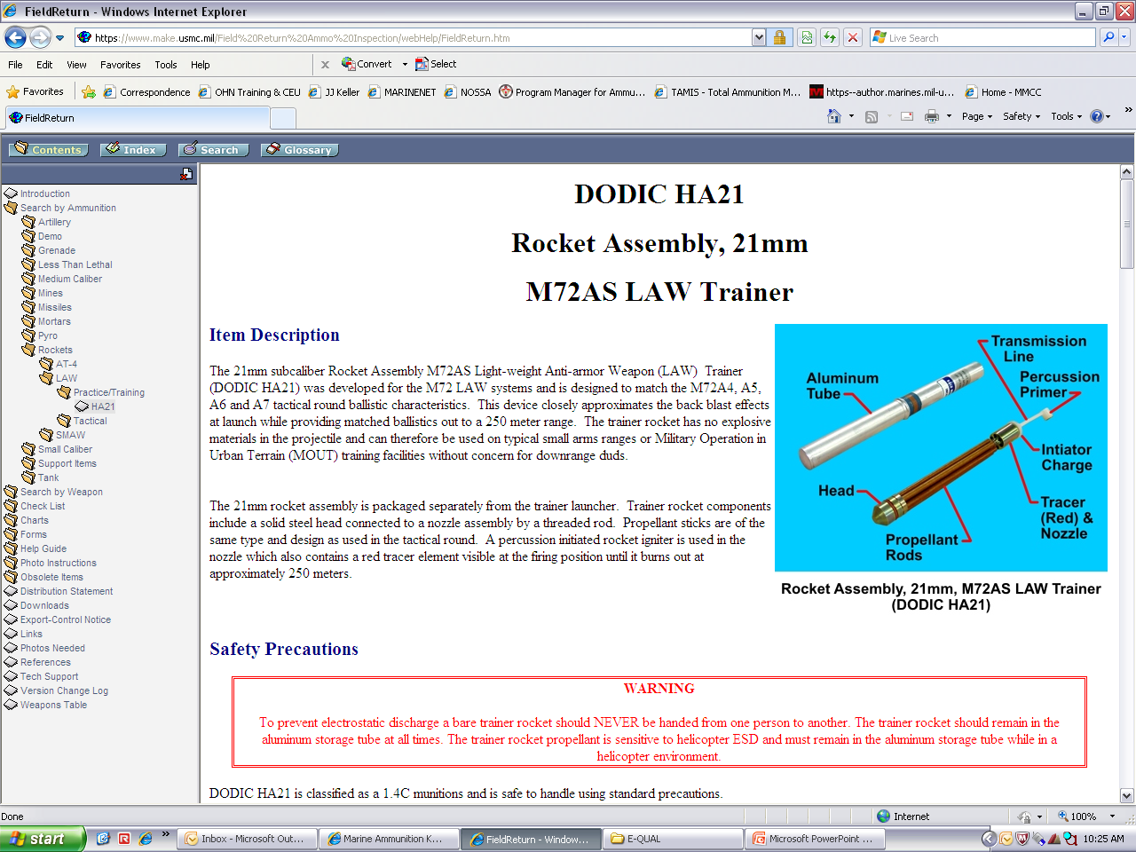
HA21
ROCKET ASSEMBLY, 21MM
M72AS LAW TRAINER

Slide 27
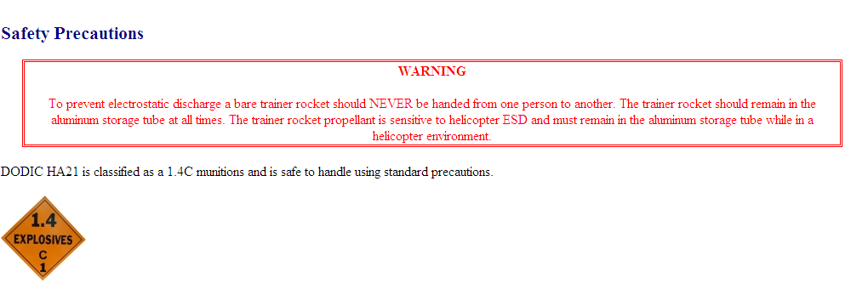
Safety precautions

Slide 28
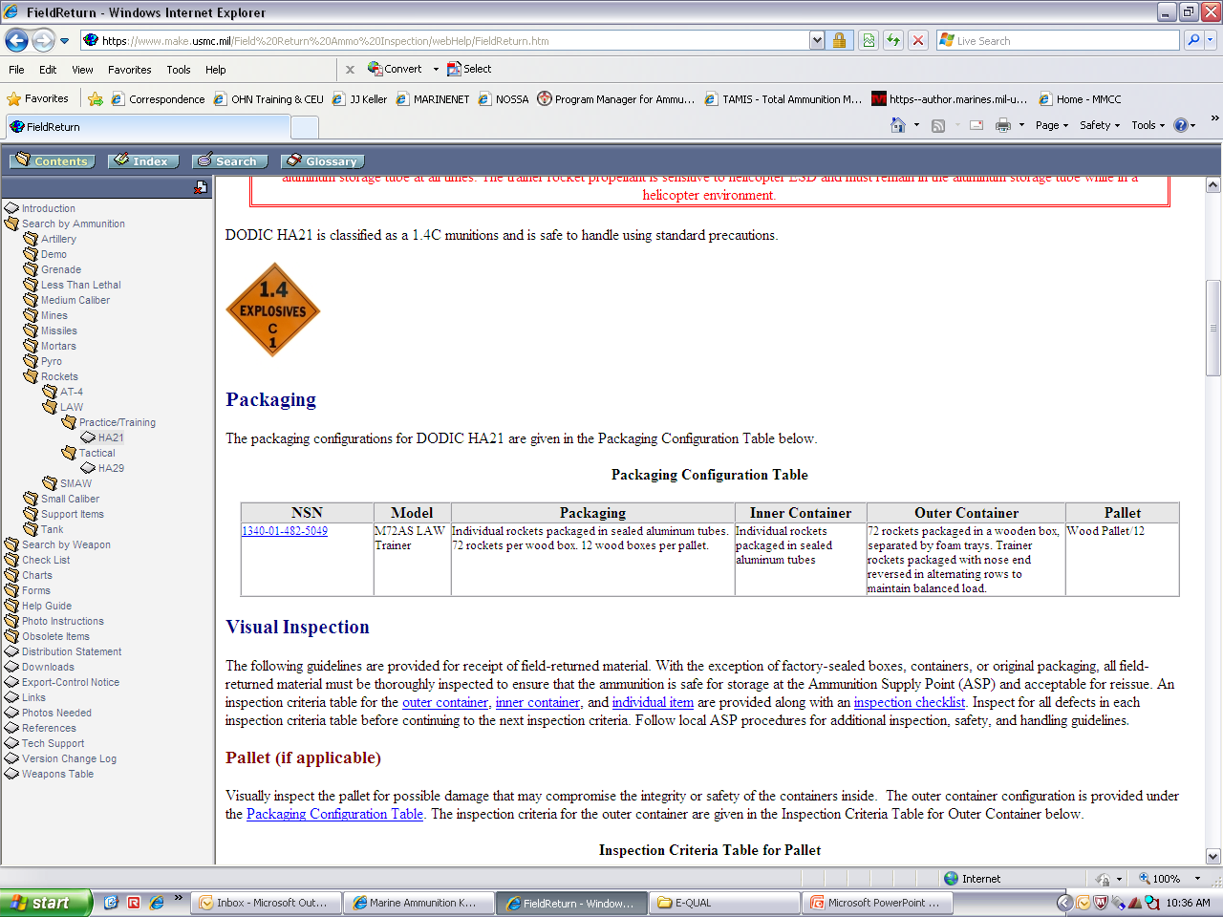
Packaging

Slide 29
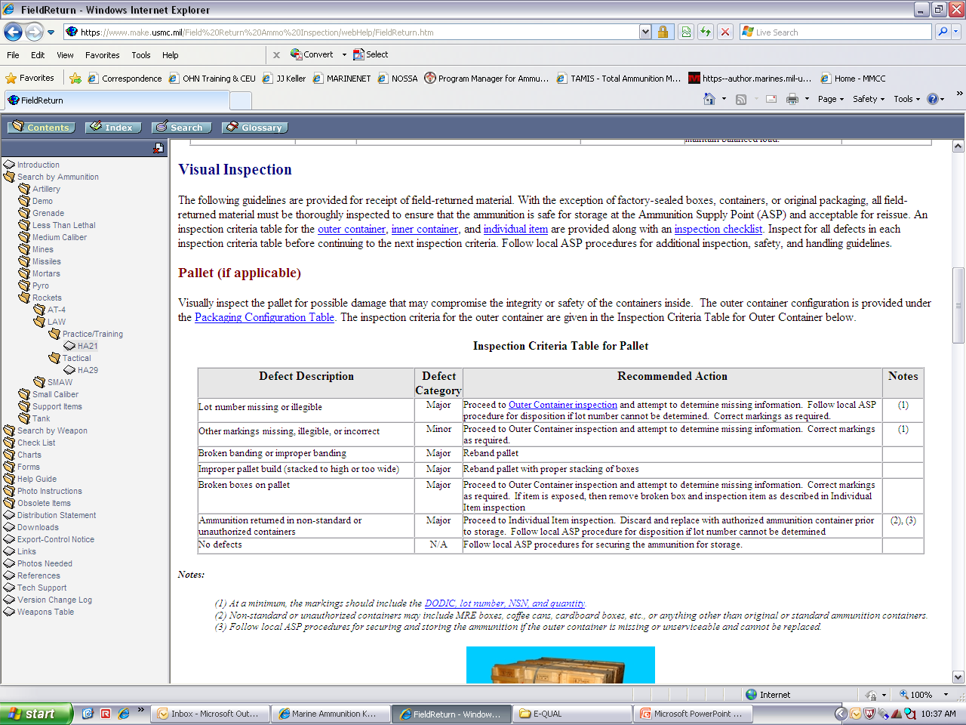
PALLET CHECKLIST

Slide 30
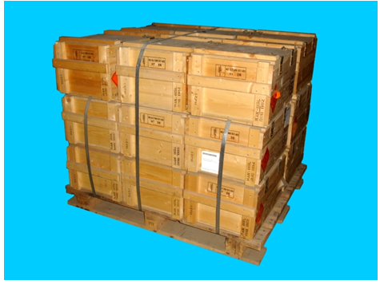
PALLET CHECKLIST (CONT)

Slide 31
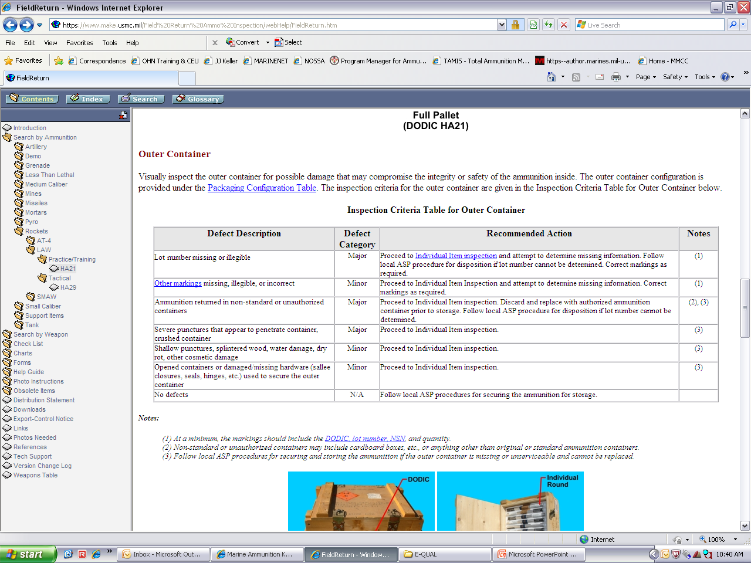
OUTER CONTAINER checklist

Slide 32
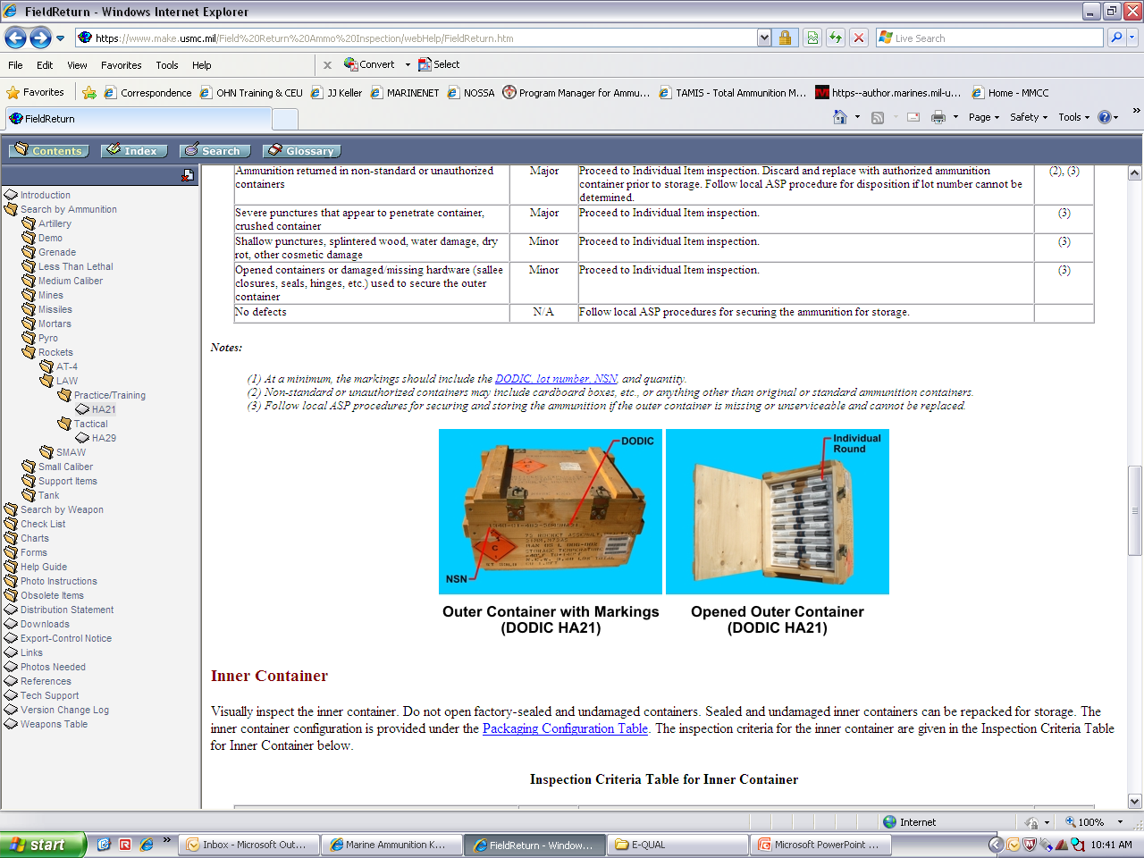
OUTER CONTAINER checklist
(CONT)

Slide 33
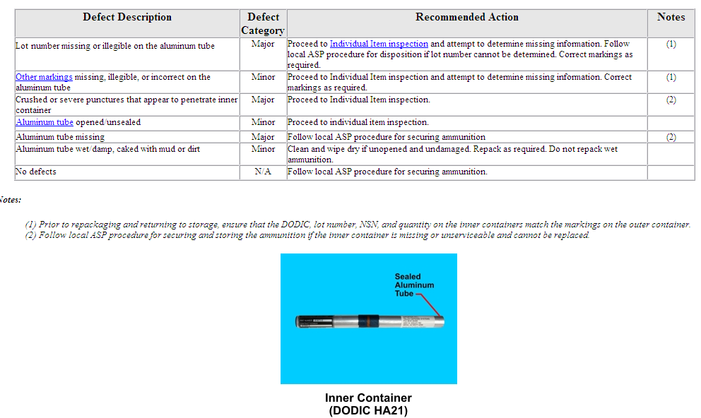
INNER CONTAINER CHECKLIST

Slide 34
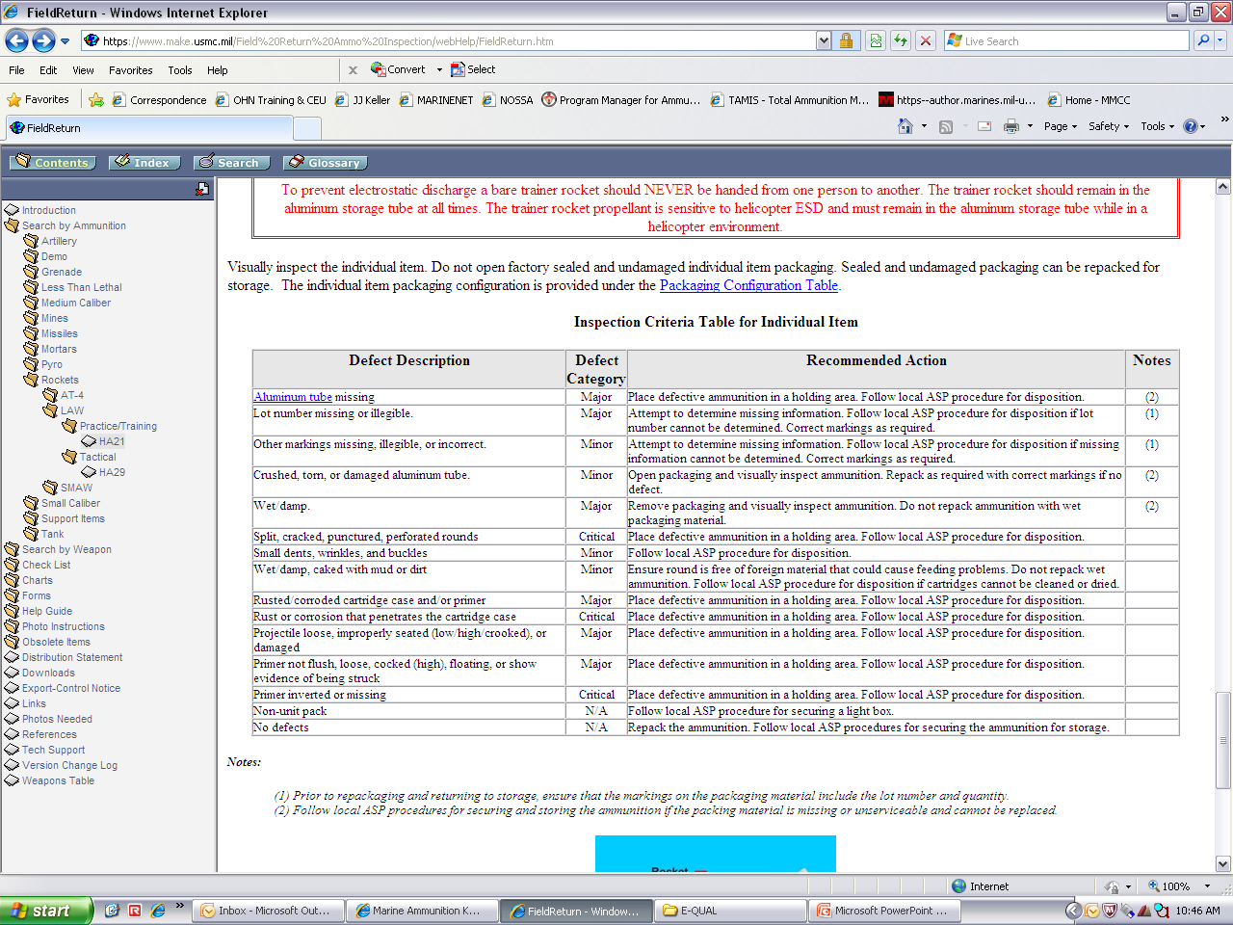
INDIVIDUAL ITEM CHECKLIST

Slide 35
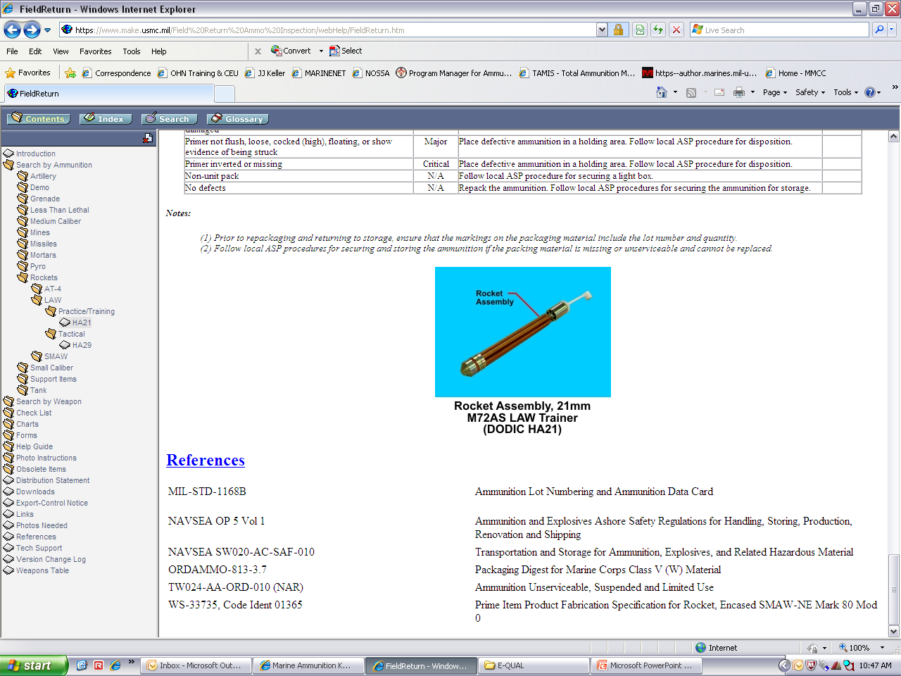
INDIVIDUAL ITEM CHECKLIST
(cont)

Slide 36
REFERENCES

Slide 37
SHOULDER-LAUNCHED MULTI-PURPOSE ASSAULT WEAPON
HA08
HA34
HX05
HX06
HX07
Rocket and Launcher, 83mm HEDP Bunker Defeat Munition (BDM), M141 (SMAW-D)
Rocket, 83mm NE, MK 80 Mod 0 (SMAW)
Rocket, 83mm Assault MK3 Mod 0 (SMAW)
Rocket, 83mm HEAA MK6 Mod 0 (SMAW)
Rocket, 83mm HEAA Practice MK7 Mod 0 (SMAW)

Slide 38
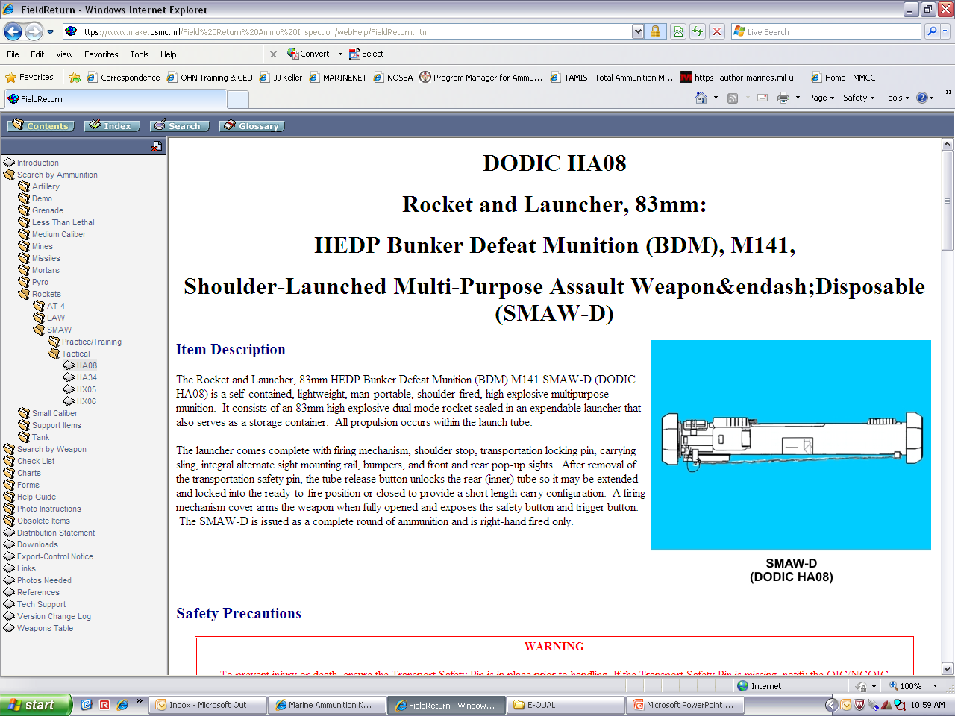
HA08
ROCKET AND LAUNCHER, 83MM
HEDP BUNKER DEFEAT MUNITION, M141 (SMAW-D)

Slide 39
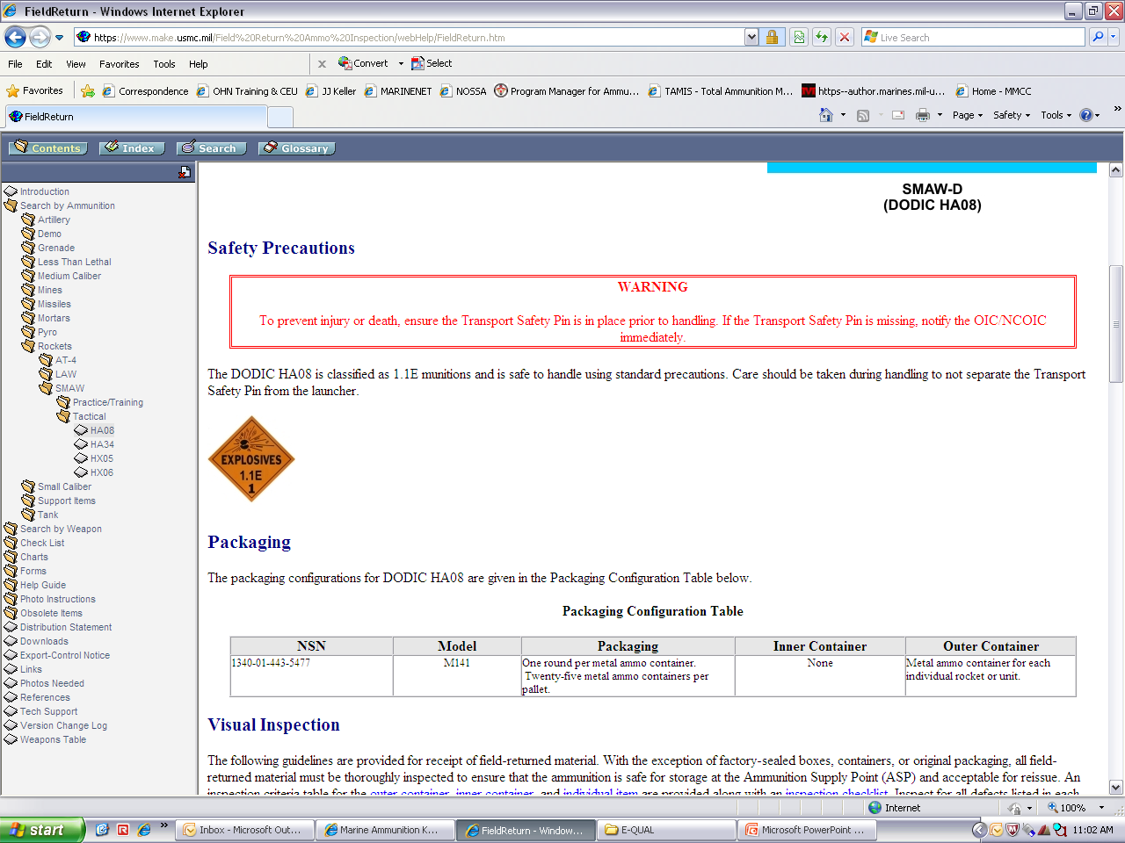
Safety precautions

Slide 40
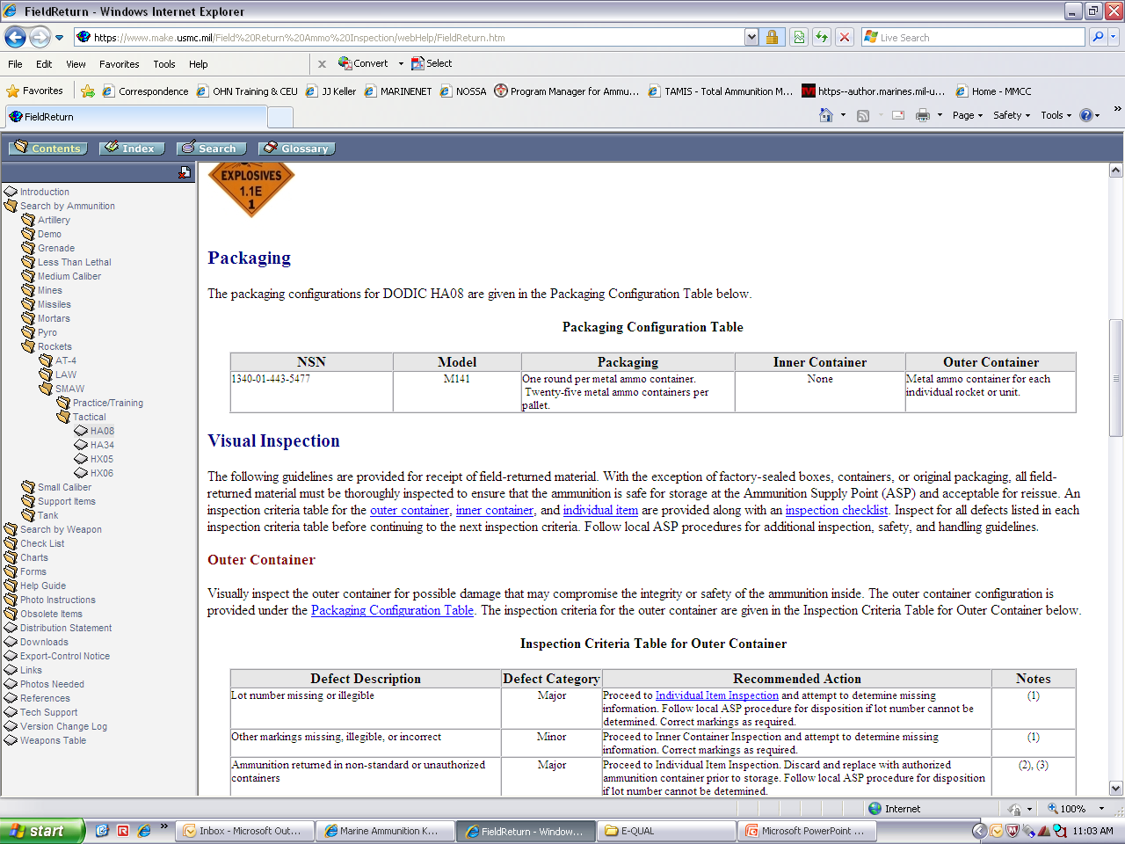
Packaging

Slide 41
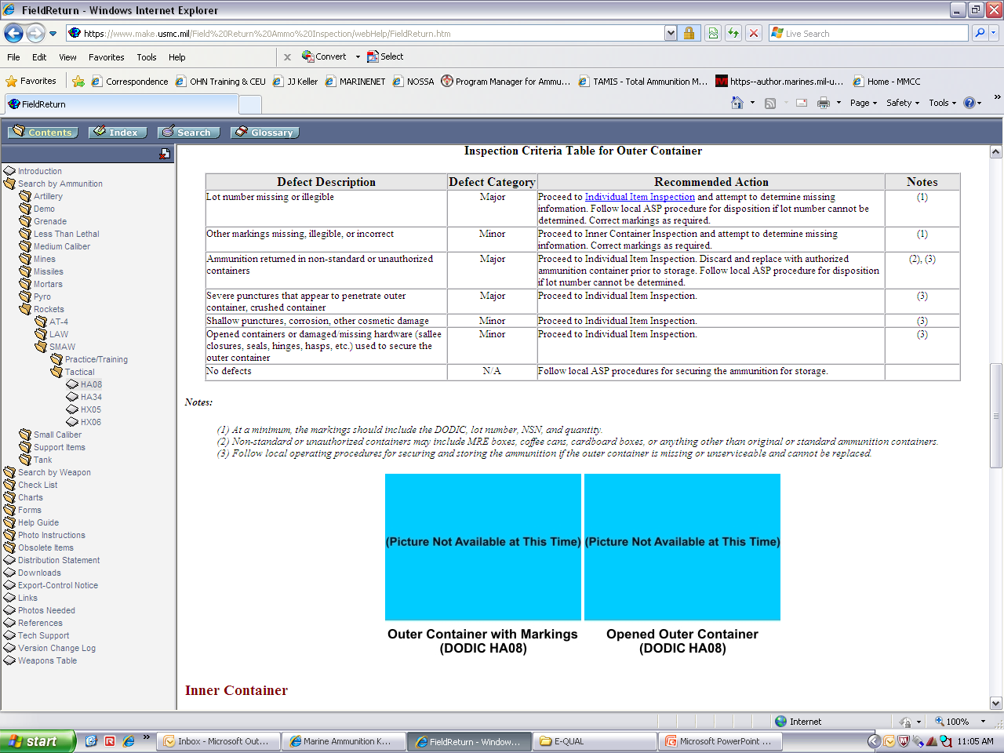
OUTER CONTAINER checklist

Slide 42
OUTER CONTAINER checklist
(CONT)

Slide 43
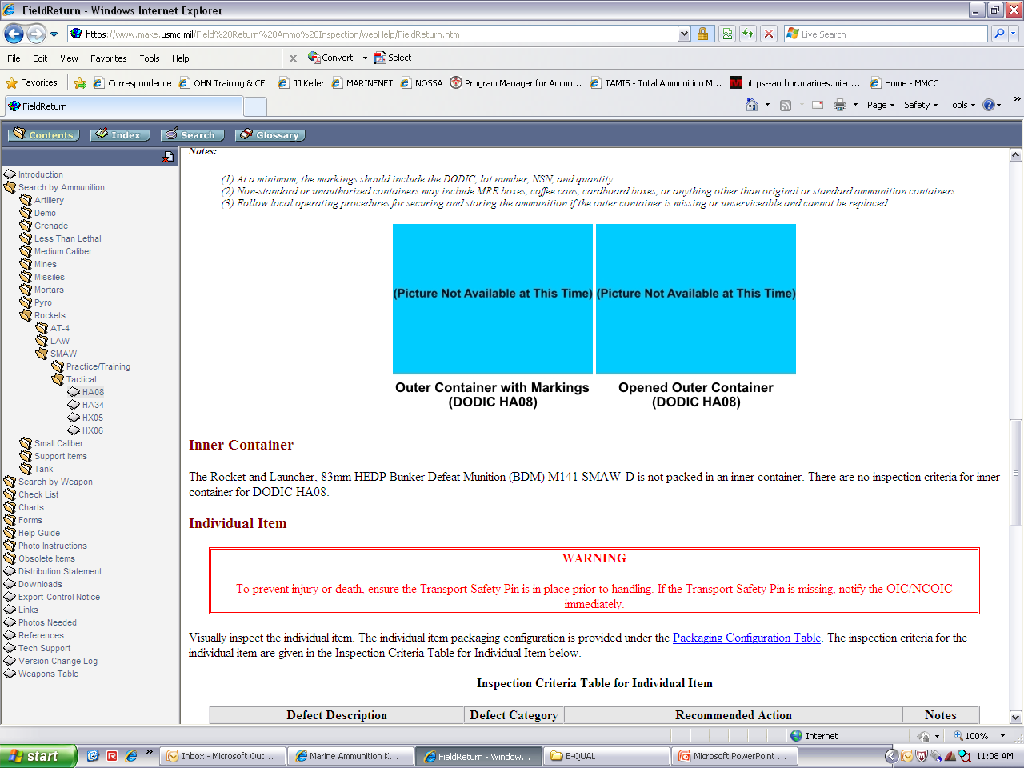
INNER CONTAINER CHECKLIST

Slide 44
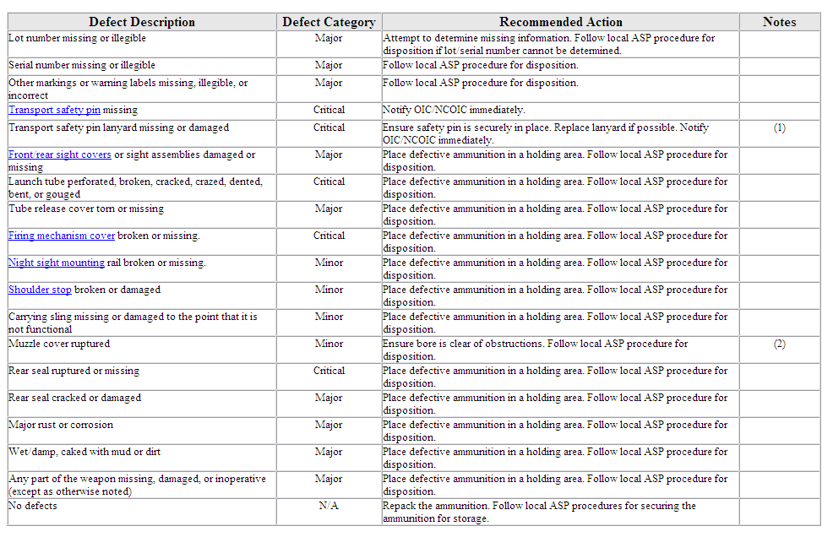
INDIVIDUAL ITEM CHECKLIST

Slide 45
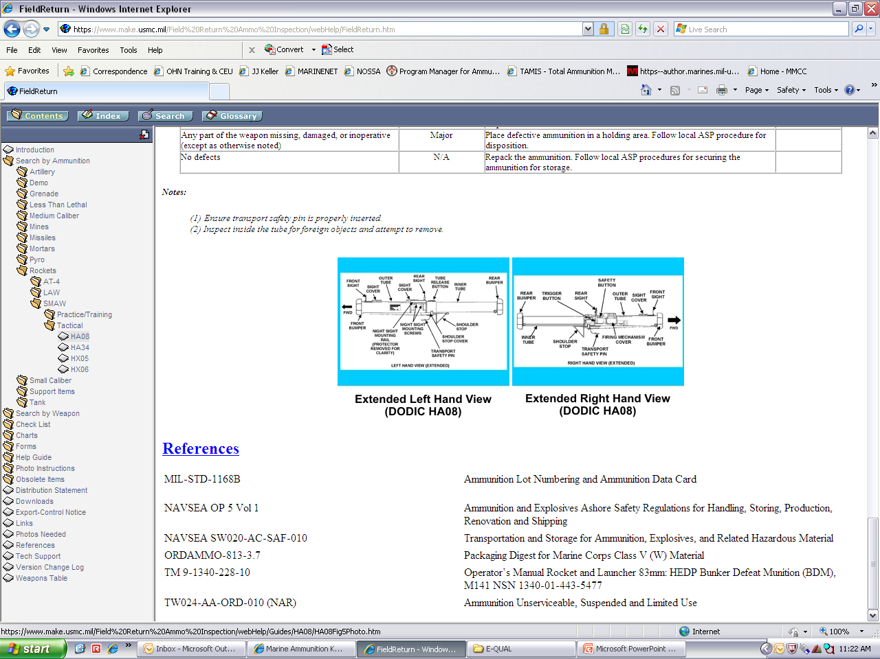
INDIVIDUAL ITEM CHECKLIST
(cont)

Slide 46
REFERENCES

Slide 47
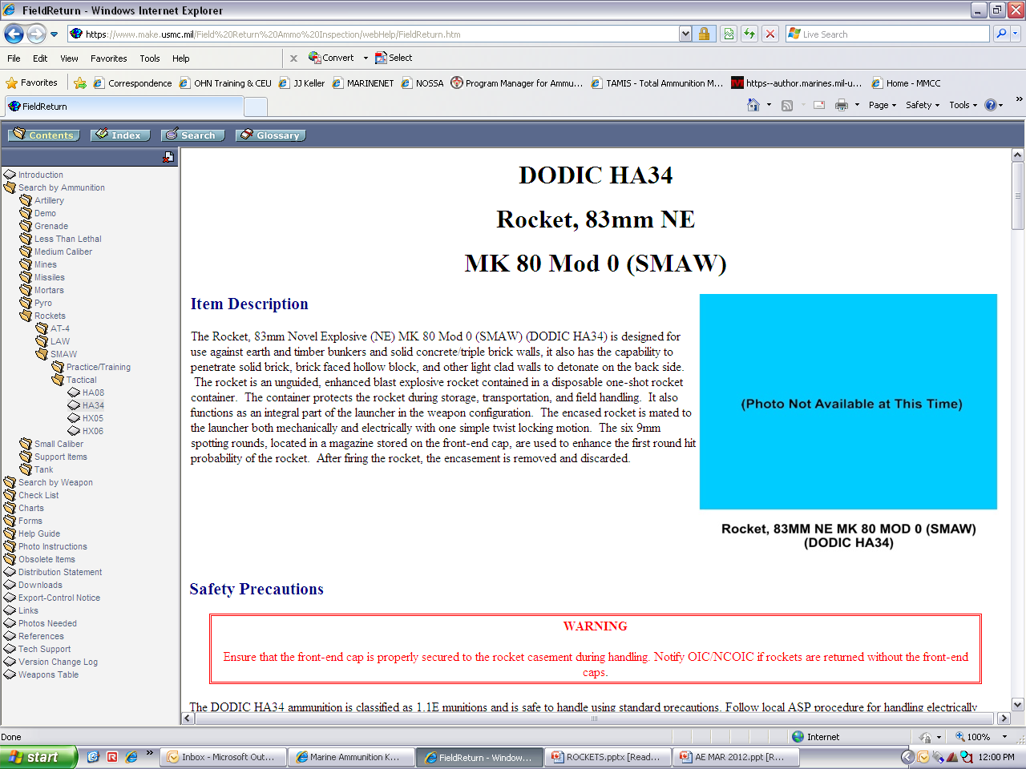
HA34
ROCKET AND LAUNCHER, 83MM ne mk 80 mod 0(SMAW)

Slide 48
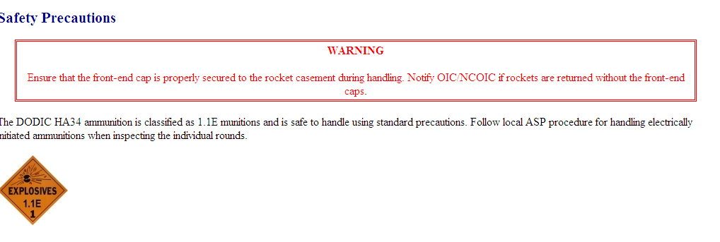
Safety precautions

Slide 49
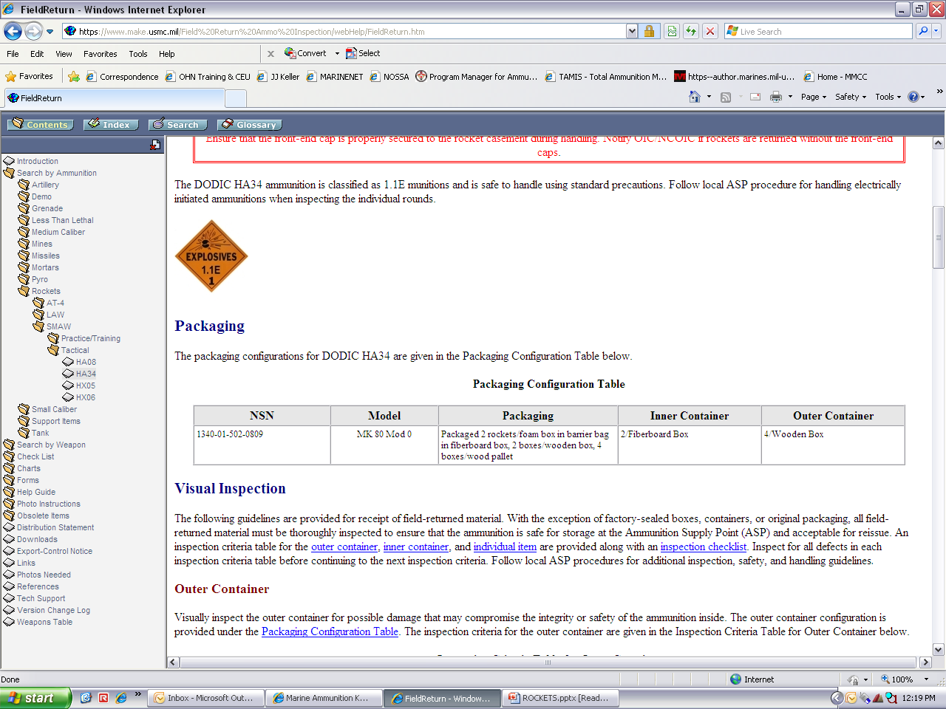
Packaging

Slide 50
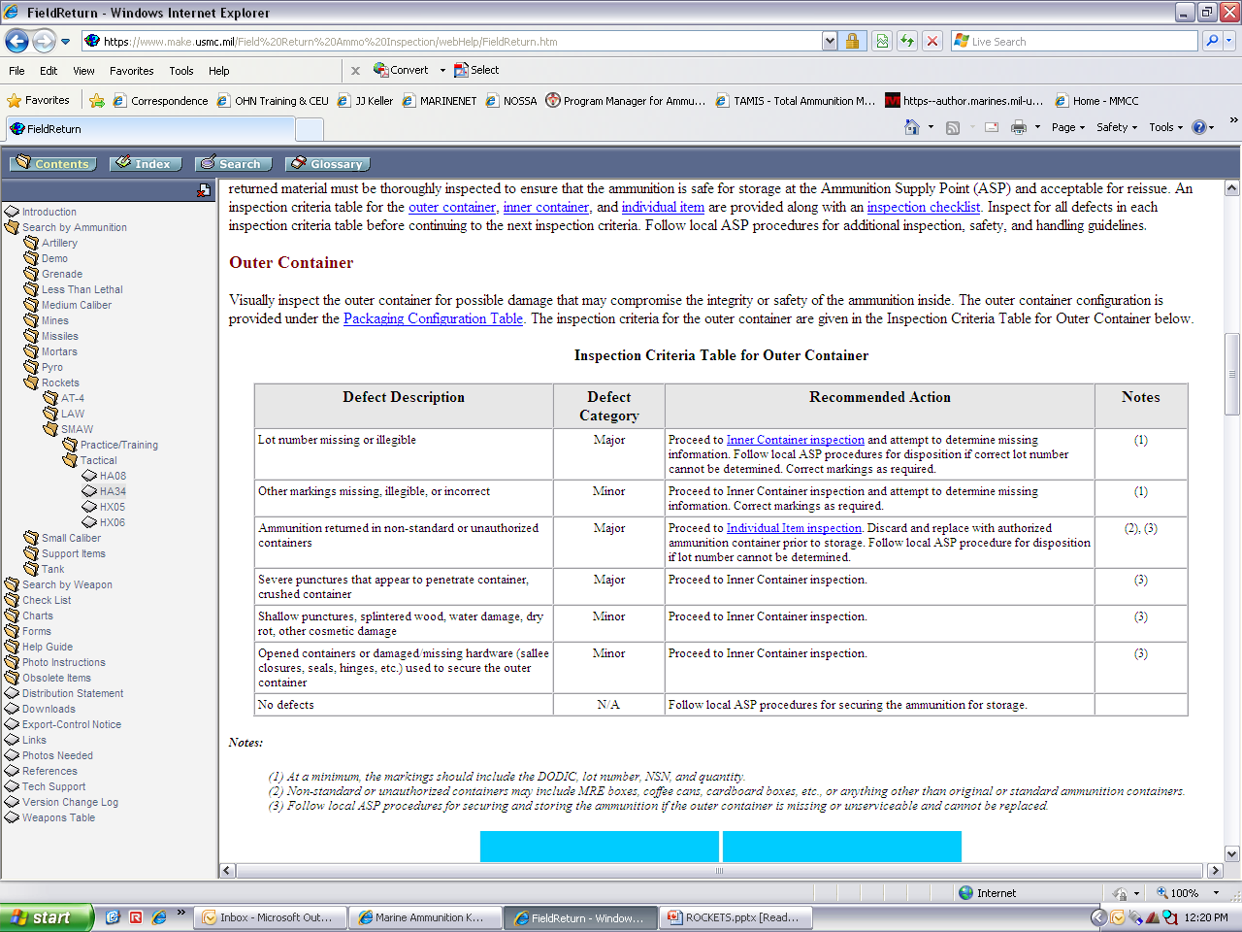
OUTER CONTAINER checklist

Slide 51
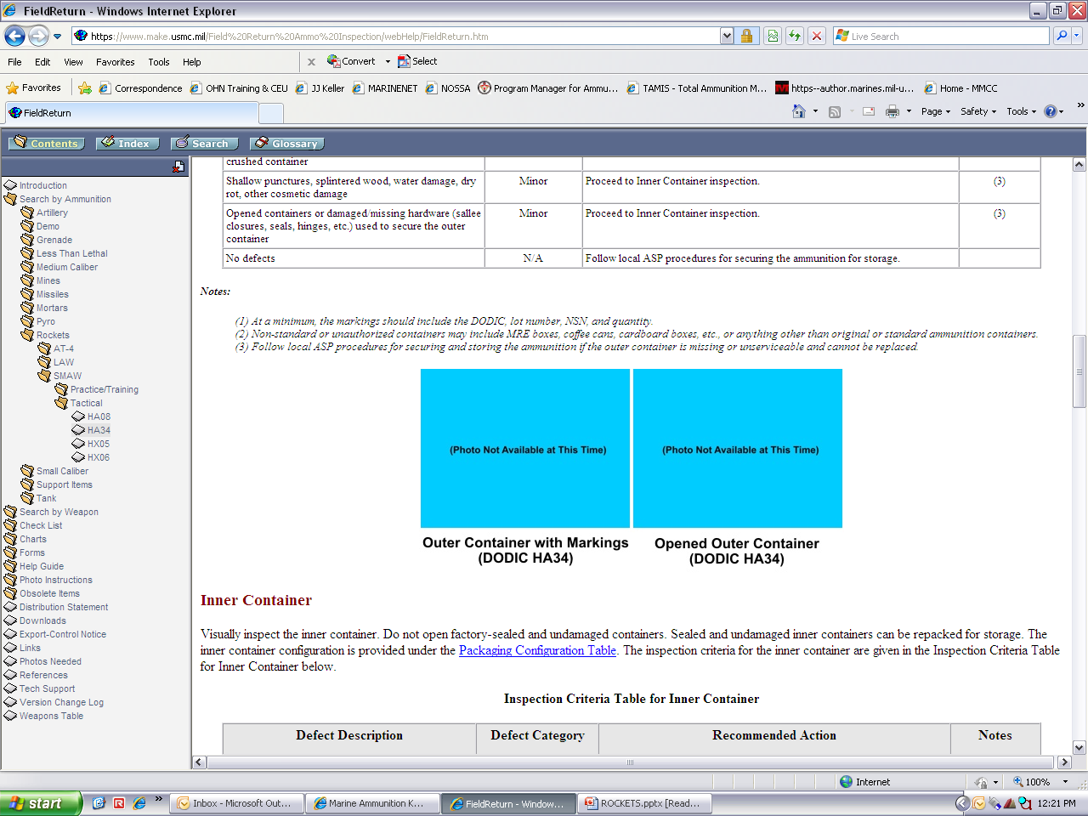
OUTER CONTAINER checklist
(CONT)

Slide 52
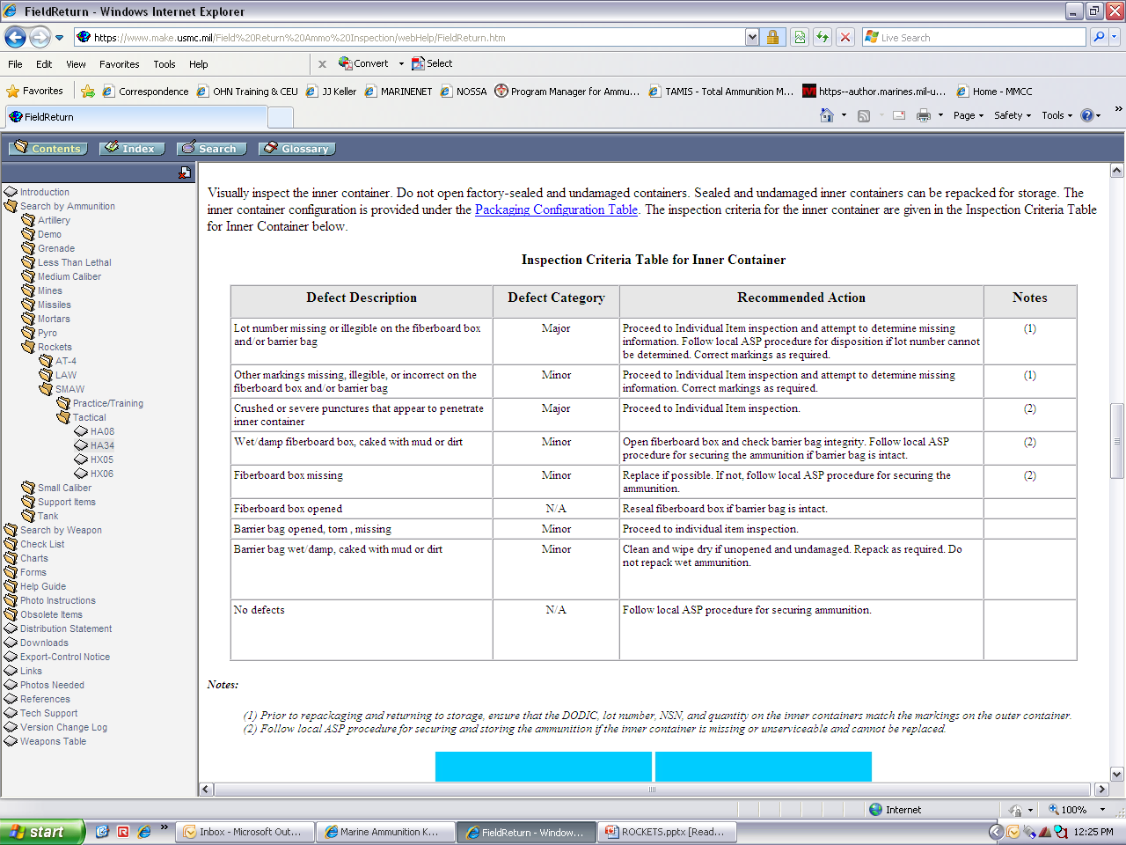
INNER CONTAINER CHECKLIST

Slide 53
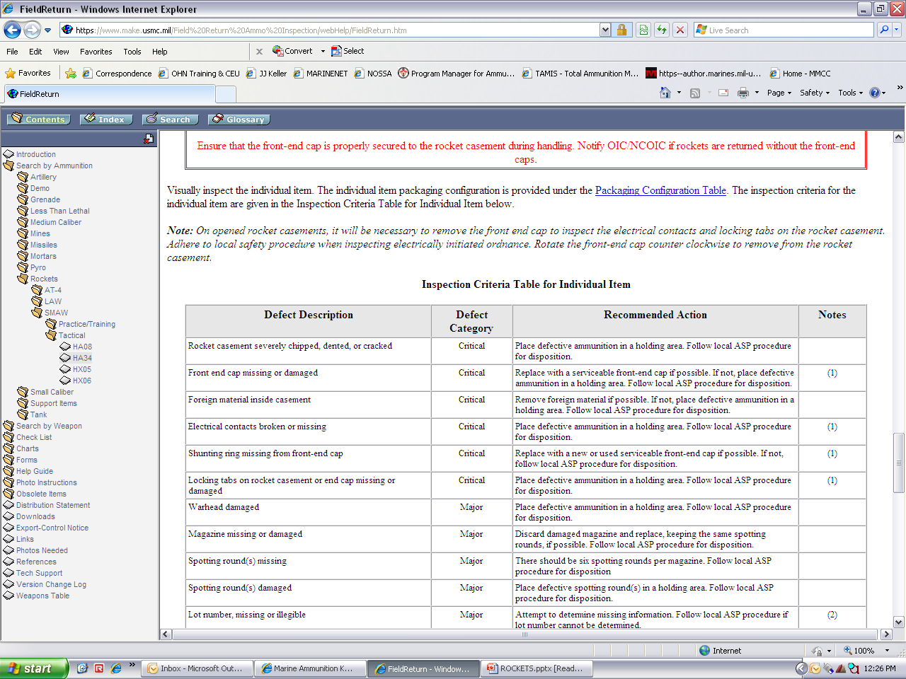
INDIVIDUAL ITEM CHECKLIST

Slide 54
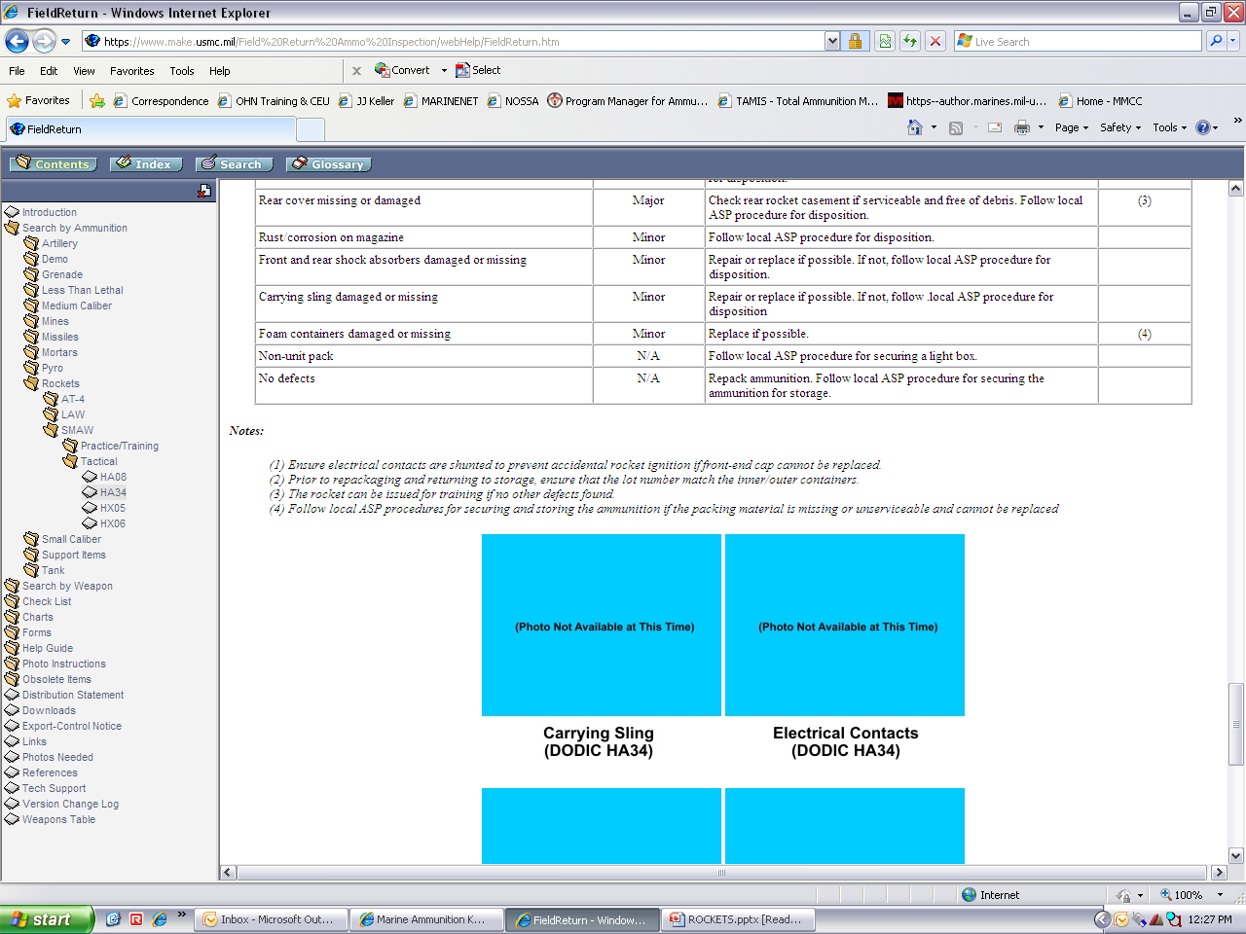
INDIVIDUAL ITEM CHECKLIST
(cont)

Slide 55
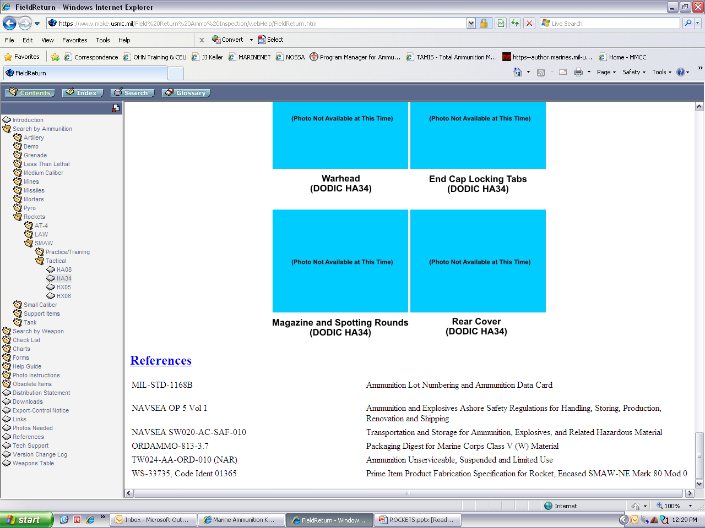
REFERENCES

Slide 56
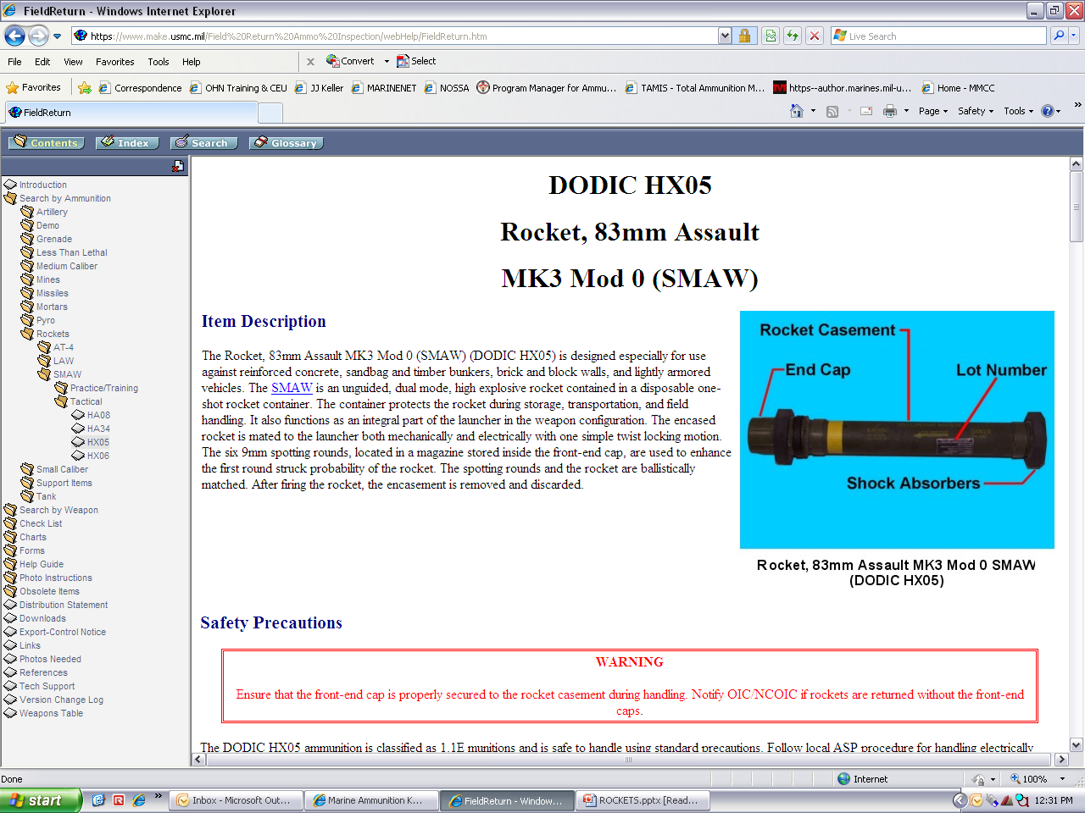
Hx05
ROCKET, 83MM assault mk3 mod 0(SMAW)

Slide 57
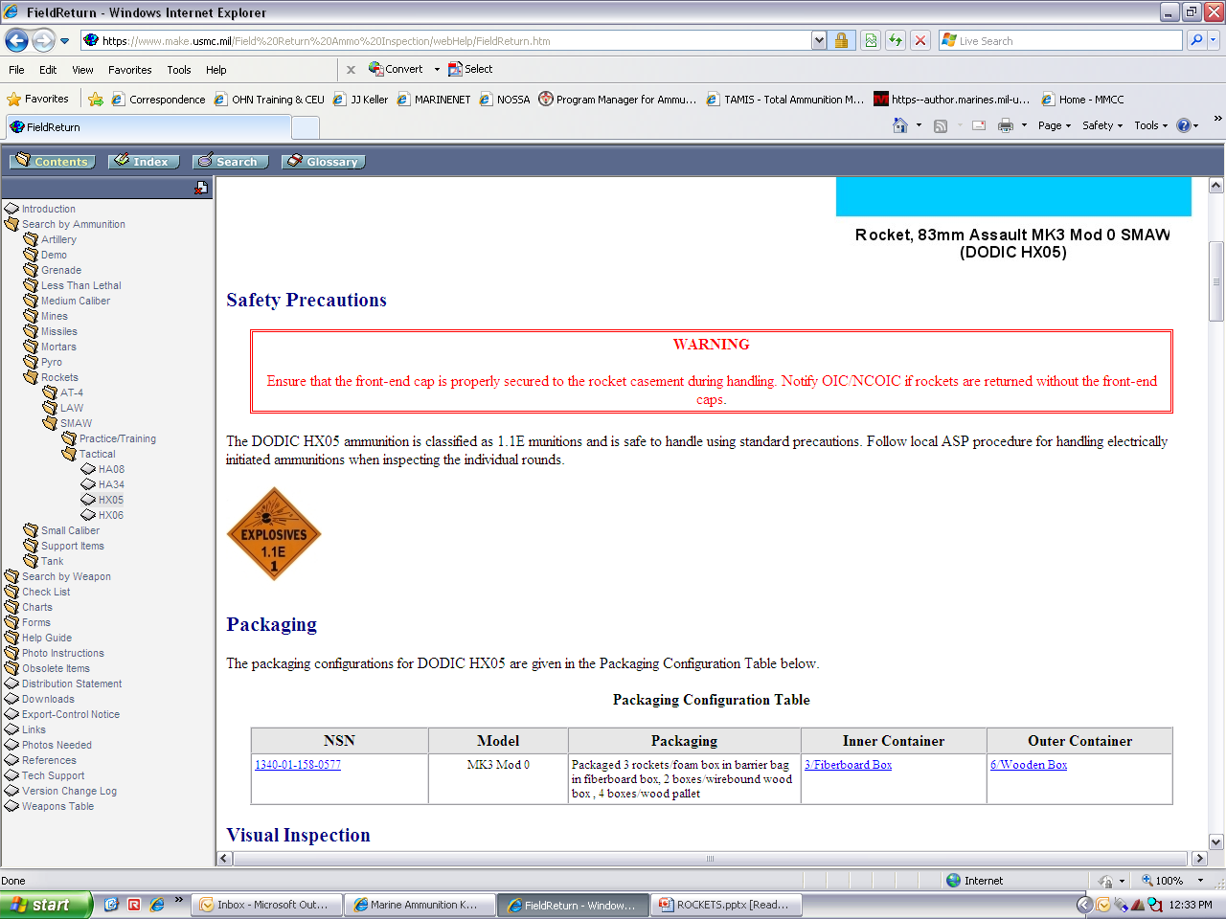
Safety precautions

Slide 58

Packaging

Slide 59

OUTER CONTAINER checklist

Slide 60

OUTER CONTAINER checklist
(CONT)

Slide 61

INNER CONTAINER CHECKLIST

Slide 62

INNER CONTAINER CHECKLIST (cont)

Slide 63

INDIVIDUAL ITEM CHECKLIST

Slide 64

INDIVIDUAL ITEM CHECKLIST
(cont)

Slide 65

INDIVIDUAL ITEM CHECKLIST
(cont)

Slide 66

REFERENCES

Slide 67

Hx06
ROCKET, 83MM heaa mk6 mod 0(SMAW)

Slide 68

Safety precautions

Slide 69

Packaging

Slide 70

OUTER CONTAINER checklist

Slide 71

OUTER CONTAINER checklist
(CONT)

Slide 72

INNER CONTAINER CHECKLIST

Slide 73

INNER CONTAINER CHECKLIST (cont)

Slide 74

INDIVIDUAL ITEM CHECKLIST

Slide 75

INDIVIDUAL ITEM CHECKLIST
(cont)

Slide 76

INDIVIDUAL ITEM CHECKLIST
(cont)

Slide 77

INDIVIDUAL ITEM CHECKLIST
(cont)

Slide 78

REFERENCES

Slide 79

Hx07
ROCKET, 83MM heaa practice mk7 mod 0(SMAW)

Slide 80

Safety precautions

Slide 81

Packaging

Slide 82

OUTER CONTAINER checklist

Slide 83

OUTER CONTAINER checklist
(CONT)

Slide 84

INNER CONTAINER CHECKLIST

Slide 85

INNER CONTAINER CHECKLIST (cont)

Slide 86

INDIVIDUAL ITEM CHECKLIST

Slide 87

INDIVIDUAL ITEM CHECKLIST
(cont)

Slide 88

INDIVIDUAL ITEM CHECKLIST
(cont)

Slide 89

REFERENCES

Slide 90



ID ROCKETS

Slide 91
TERMINAL LEARNING OBJECTIVE
ACTION: Identify rockets, by its markings, colors, and distinct features.
CONDITIONS: Given, in a contemporary operating environment (COE), classroom instruction, selected inert rocket munitions, slides, reference materials, student H/O and PE.
STANDARDS: Identify the various rockets and successfully pass the PE with 70% (at a minimum) and Annex A examinations.
SAFETY REQUIREMENTS: None
SAFETY AWARENESS: None
RISK ASSESSMENT LEVEL: IV E No Risk
ENVIRONMENTAL CONSIDERATIONS: None

Slide 92




GENERAL CHARACTERISTICS
A military rocket consists of four components:
    - Fuze
    - Warhead
    - Rocket motor
    - Fin assembly
A rocket launcher holds the rocket and provides initial guidance and electrical contacts for firing
Launchers are mounted on vehicles, or aircraft

Slide 93

TYPICAL 2.75 INCH ROCKETS
The 2.75 inch (FFAR) Folding Fin, Aircraft Rockets are air to ground rockets designed for deployment from rotary winged and other low speed aircraft.
Provided with a variety of warheads, they have a wide tactical application with high point target effectiveness.

Slide 94
AME AND STUDENT-OUT
REFERENCES: AME, Yellow Book, and TM
DODICs: H974, HA14, H164, HA11, H519, H181,
J146/HA07, H185, H557, HA34, and HX06

Slide 95


MULTIPLE LAUNCH RKT SYSTEM (MLRS)
Two main components
  - Rocket assembly
  - Rocket Pod, Launcher pod container (LPC)

Slide 96

MLRS ROCKET ASSEMBLY
Characteristics
- Tube launched
- Free flight rockets
- Spin stabilized
Components
- Fuze
- Warhead Assembly
- Rkt Motor Assembly
- 4 Spring loaded canted
fins w/a fin opening
restraint device
Payload
- Each warhead contains 4
sabots and over 600 sub-
munitions
Dimensions
L- 12’11” x W- 3’4” x H- 2’7”
Weight 683.55 lbs

Slide 97


MLRS ROCKET ASSEMBLY

Slide 98
SUMMARY
Various rockets and how to identify them
Color codes
Components of 2.75 Rkts
MLRS
83MM and 66MM Rockets
Intended use
Questions

Slide 99
ID ROCKETS

Slide 100
TERMINAL LEARNING OBJECTIVE
ACTION: Identify rockets, by its markings, colors, and distinct features.
CONDITIONS: Given, in a contemporary operating environment (COE), classroom instruction, selected inert rocket munitions, slides, reference materials, student H/O and PE.
STANDARDS: Identify the various rockets and successfully pass the PE with 70% (at a minimum) and Annex A examinations.
SAFETY REQUIREMENTS: None
SAFETY AWARENESS: None
RISK ASSESSMENT LEVEL: IV E No Risk
ENVIRONMENTAL CONSIDERATIONS: None

Slide 101
GENERAL CHARACTERISTICS
A military rocket consists of four components:
    - Fuze
    - Warhead
    - Rocket motor
    - Fin assembly
A rocket launcher holds the rocket and provides initial guidance and electrical contacts for firing
Launchers are mounted on vehicles, or aircraft

Slide 102
TYPICAL 2.75 INCH ROCKETS
The 2.75 inch (FFAR) Folding Fin, Aircraft Rockets are air to ground rockets designed for deployment from rotary winged and other low speed aircraft.
Provided with a variety of warheads, they have a wide tactical application with high point target effectiveness.

Slide 103
AME AND STUDENT-OUT
REFERENCES: AME, Yellow Book, and TM
DODICs: H974, HA14, H164, HA11, H519, H181,
J146/HA07, H185, H557, HA34, and HX06

Slide 104
MULTIPLE LAUNCH RKT SYSTEM (MLRS)
Two main components
  - Rocket assembly
  - Rocket Pod, Launcher pod container (LPC)

Slide 105
MLRS ROCKET ASSEMBLY
Characteristics
- Tube launched
- Free flight rockets
- Spin stabilized
Components
- Fuze
- Warhead Assembly
- Rkt Motor Assembly
- 4 Spring loaded canted
fins w/a fin opening
restraint device
Payload
- Each warhead contains 4
sabots and over 600 sub-
munitions
Dimensions
L- 12’11” x W- 3’4” x H- 2’7”
Weight 683.55 lbs

Slide 106
MLRS ROCKET ASSEMBLY

Slide 107
SUMMARY
Various rockets and how to identify them
Color codes
Components of 2.75 Rkts
MLRS
83MM and 66MM Rockets
Intended use
Questions

